Slide 1
Beyond Mental Health: Can we achieve emotional healing in IBD?
Laurie Keefer, PhD
Professor of Medicine and Psychiatry
Icahn School of Medicine at Mount Sinai
Notes:
I think this is great- I can focus more on the psychological aspects outside of comorbid depression and anxiety and how a positive psych framework/integrated approach could help!.

Slide 2
Psychological comorbidities are a common extraintestinal manifestation of IBD, and the cause is likely bi-directional
Depressive Symptoms
Anxiety
Medical Trauma
Barberio, B., et al. (2021). "Prevalence of symptoms of anxiety and depression in patients with inflammatory bowel disease: a systematic review and meta-analysis." Lancet Gastroenterol Hepatol.
Taft TH et al., (2019). ”Initial Assessment of Post-traumatic Stress in a US Cohort of Inflammatory Bowel Disease Patients. “ Inflamm Bowel Dis
Notes:
The prevalence of mental health comorbidity in IBD remains stagnant despite 1) improvements in IBD medical treatment; 2) screening initiatives; and 3) Patient desire
Why? Because we intervene too late! Most patients develop these conditions AFTER a diagnosis of IBD, particularly in the first year after diagnosis.
The problem is bi-directional; as patients become more depressed and anxious, they are less likely to self-manage; as patients fail to self-manage, they are more likely to become depressed and anxious.
In the US, we are even seeing up to 30% PTS
Barberio, B., et al. (2021). "Prevalence of symptoms of anxiety and depression in patients with inflammatory bowel disease: a systematic review and meta-analysis." Lancet Gastroenterol Hepatol.
BACKGROUND: Inflammatory bowel disease (IBD) is a lifelong condition with no cure. Patients with IBD might experience symptoms of common mental disorders such as anxiety and depression because of bidirectional communication via the gut-brain axis and chronicity of symptoms, and because of impaired quality of life and reduced social functioning. However, uncertainties remain about the magnitude of this problem. We aimed to assess prevalence of symptoms of anxiety or depression in adult patients with IBD. METHODS: In this systematic review and meta-analysis, we searched MEDLINE, Embase, Embase Classic, and PsycINFO for papers published from inception to Sept 30, 2020, reporting observational studies that recruited at least 100 adult patients with IBD and that reported prevalence of symptoms of anxiety or depression according to validated screening instruments. We excluded studies that only used a structured interview to assess for these symptoms and studies that did not provide extractable data. We extracted data from published study reports and calculated pooled prevalences of symptoms of anxiety and depression, odds ratios (OR), and 95% CIs. FINDINGS: Of 5544 studies identified, 77 fulfilled the eligibility criteria, including 30 118 patients in total. Overall, pooled prevalence of anxiety symptoms was 32.1% (95% CI 28.3-36.0) in 58 studies (I(2)=96.9%) and pooled prevalence of depression symptoms was 25.2% (22.0-28.5) in 75 studies (I(2)=97.6%). In studies that reported prevalence of anxiety or depression in patients with Crohn's disease and ulcerative colitis within the same study population, patients with Crohn's disease had higher odds of anxiety symptoms (OR 1.2, 95% CI 1.1-1.4) and depression symptoms (1.2, 1.1-1.4) than patients with ulcerative colitis. Overall, women with IBD were more likely to have symptoms of anxiety than were men with IBD (pooled prevalence 33.8% [95% CI 26.5-41.5] for women vs 22.8% [18.7-27.2] for men; OR 1.7 [95% CI 1.2-2.3]). They were also more likely to have symptoms of depression than men were (pooled prevalence 21.2% [95% CI 15.4-27.6] for women vs 16.2% [12.6-20.3] for men; OR 1.3 [95% CI 1.0-1.8]). The prevalence of symptoms of anxiety (57.6% [95% CI 38.6-75.4]) or depression (38.9% [26.2-52.3]) was higher in patients with active IBD than in patients with inactive disease (38.1% [30.9-45.7] for anxiety symptoms and 24.2% [14.7-35.3] for depression symptoms; ORs 2.5 [95% CI 1.5-4.1] for anxiety and 3.1 [1.9-4.9] for depression). INTERPRETATION: There is a high prevalence of symptoms of anxiety and depression in patients with IBD, with up to a third of patients affected by anxiety symptoms and a quarter affected by depression symptoms. Prevalence was also increased in patients with active disease: half of these patients met criteria for anxiety symptoms and a third met criteria for depression symptoms. Encouraging gastroenterologists to screen for and treat these disorders might improve outcomes for patients with IBD. FUNDING: None.
Keefer, L. (2021). "What can we do to tackle anxiety and depression in patients with inflammatory bowel disease?" Lancet Gastroenterol Hepatol.
Hart, A. L., et al. (2017). "What Are the Top 10 Research Questions in the Treatment of Inflammatory Bowel Disease? A Priority Setting Partnership with the James Lind Alliance." J Crohns Colitis 11(2): 204-211.
BACKGROUND AND AIMS: Many uncertainties remain regarding optimal therapies and strategies for the treatment of inflammatory bowel disease. Setting research priorities addressing therapies requires a partnership between health care professionals, patients and organisations supporting patients. We aimed to use the structure of the James Lind Alliance Priority Setting Partnership, which has been used in other disease areas, to identify and prioritise unanswered questions about treatments for inflammatory bowel disease. METHODS: The James Lind Priority Setting Partnership uses methods agreed and adopted in other disease areas to work with patients and clinicians: to identify uncertainties about treatments; to agree by consensus a prioritised list of uncertainties for research; then to translate these uncertainties into research questions which are amenable to hypothesis testing; and finally to take results to research commissioning bodies to be considered for funding. RESULTS: A total of 1636 uncertainties were collected in the initial survey from 531 respondents, which included 22% health care professionals and 78% patients and carers. Using the rigorously applied processes of the priority setting partnership, this list was distilled down to the top 10 research priorities for inflammatory bowel disease. The top priorities were: identifying treatment strategies to optimise efficacy, safety and cost-effectiveness; and stratifying patients with regard to their disease course and treatment response. Diet and symptom control [pain, incontinence and fatigue] were also topics which were prioritised. CONCLUSIONS: A partnership involving multidisciplinary clinicians, patients and organisations supporting patients has identified the top 10 research priorities in the treatment of patients with inflammatory bowel disease.

Slide 3
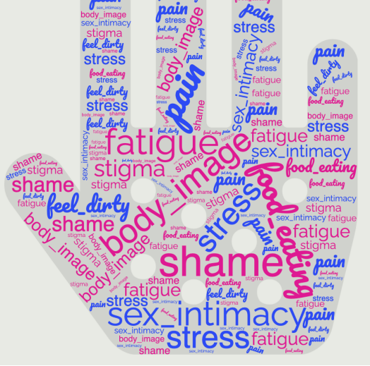
But….. Psychological disorders are only part of the emotional burden
Adapted from: Keefer et al., How should pain, fatigue and emotional wellness be incorporated into treatment goals for optimal management of IBD? Gastroenterology. 2022.
Notes:
Depression and Anxiety are not the only concerns that IBD patients hold- I fact, I would go so far as to argue that these feelings are precursors to Depression and Anxiety!

Slide 4
Patients want emotional aspects of their health addressed as part of routine IBD care
95% of IBD patients agree that stress, quality of life, and mental health should be addressed by their medical providers.¹
Between 38-50% of IBD patients report seeking out or desire for psychotherapy to address IBD specific issues, and believe stress influences the course of their disease.^{1,2}
When psychological needs are addressed in the IBD setting, outcomes improve
¹Craven, M. R., et al. (2019). Inflammatory Bowel Disease Patient Experiences with Psychotherapy in the Community. J Clin Psychol Med Settings, 26(2), 183-193.
²Klag, T., et al. (2017). High Demand for Psychotherapy in Patients with Inflammatory Bowel Disease. Inflamm Bowel Dis, 23(10), 1796-1802.
³Regueiro, M., ….. Szigethy, E. (2018). Reduced Unplanned Care and Disease Activity and Increased Quality of Life After Patient Enrollment in an Inflammatory Bowel Disease Medical Home. Clin Gastroenterol Hepatol, 16(11), 1777-1785.
Notes:
No more Silos!
Craven, M. R., Quinton, S., & Taft, T. H. (2019). Inflammatory Bowel Disease Patient Experiences with Psychotherapy in the Community. J Clin Psychol Med Settings, 26(2), 183-193. https://doi.org/10.1007/s10880-018-9576-5
Klag, T., Mazurak, N., Fantasia, L., Schwille-Kiuntke, J., Kirschniak, A., Falch, C., Goetz, M., Malek, N. P., Enck, P., & Wehkamp, J. (2017). High Demand for Psychotherapy in Patients with Inflammatory Bowel Disease. Inflamm Bowel Dis, 23(10), 1796-1802. https://doi.org/10.1097/MIB.0000000000001216

Slide 5
The Emotional Burden of IBD Self-Management
Managing Symptoms
Managing Medications and Insurance
Managing Surgeries and/or Procedures
Managing Nutrition and Lifestyle
Managing Emotions and Stress
Managing Relationships
What about living a meaningful life?
Adapted from Keefer and Kane, Self Management of IBD 2015

Slide 6
A Shift in Treat-To-Target Care is Necessary!
Absence of psychiatric symptoms does not mean a patient is emotionally well!
IBD providers can address emotional health needs as part of a treat-to-target approach to care.
Keefer L….Hart A. Gastro,2022,
Notes:
Any more than an absence of physical symptoms means that mucosal healing has occurred

Slide 7
The science is there now, but were we asking the right questions?
What if we could prevent the onset of psychological distress and optimize well-being in our chronic digestive conditions?
Notes:
Key especially as we are brain-gut

Slide 8
Disease Acceptance
Realistic Optimism
Self-Regulation
Self-Efficacy
Social Support
Interfering Behaviors:
Emotional representation of illness/health, psychological inflexibility or rigidity
Outcome:
Non-adherence, low disease knowledge
Interfering behaviors:
Low or negative social support, difficulties with care team
Outcome:
Inability to manage impact of stress, non-adherence
Interfering Behaviors:
Low sense of confidence in skills or ability to learn new things
Outcome:
Low sense of agency, external locus of control, Limited skills, avoidance
Interfering Behaviors:
Negative affect/neuroticism/ pessimism
Outcome:
Low motivation/ability to change or persist at new treatment
Interfering Behaviors:
Catastrophizing, Fear of discomfort, hypervigilance towards body, limited distress tolerance
Outcome:
High symptom reporting
The most common disease interfering self-management behaviors in IBD
Notes:
The Resilience 5 is what we use at Mount Sinai and is the culmination of my 20 years of self-management research so not sure how else to “tone down” as this is not something related to Trellus per se.

Slide 9
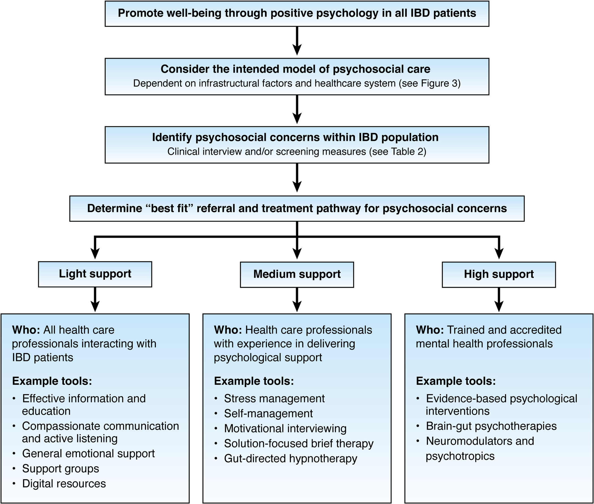
An Algorithm to Resilience-Based IBD Care
Keefer L….Hart A. Gastro, 2022
Notes:
WELL-BEING REVIEW OF SYSTEMS
How is your energy level?
Are you experiencing any pain (follow up on location, quality and severity)
How have you been handling things emotionally? How has your mood been?
Have you noticed yourself worrying or being more anxious lately?
What worries you most about your symptoms/IBD?
Are you having any trouble moving forward since your diagnosis?
Many people experience changes in their sexual functioning over the course of their IBD- has this been the case for you at all?
Is there anything you are looking forward to these days?
Who has been supporting you?

Slide 10
Applied Positive Psychology Interventions Promote Resilience in Chronic Conditions
Be engaged
Practice mindfulness
Focus on one’s character strengths
Find meaning
Seek out, belong to, and serve something larger than oneself
Live by one’s own values
Cultivate positive emotions
Cultivate, notice, and deepen feelings of joy, humor, excitement, serenity, interest, hope, and love
Do not deny, suppress, or ignore negative emotions
3 blessings – write down 3 things that went well at the end of each day
Build positive relationships
Practice gratitude
Constructively respond to positive events by asking questions and showing enthusiasm
Practice self-compassion
REVAMP Model:
6 Domains
of Well-Being
Recognize accomplishments
Gain a sense of mastery and ownership of one’s own life
Set SMART goals
Practice vitality
Feel awake, alive, and able to tackle life through exercise, a well-balanced diet, and adequate sleep
Feingold, J., Murray, H. B., & Keefer, L. (2019). Recent Advances in Cognitive Behavioral Therapy For Digestive Disorders and the Role of Applied Positive Psychology Across the Spectrum of GI Care. J Clin Gastroenterol, 53(7), 477-485.
Notes:
Main Points:
There is growing evidence that cognitive behavioral therapy (CBT) can reduce (or even remit) GI symptoms, reduce fear and anxiety about GI symptoms, and improve quality of life (QOL)
Despite the benefits of CBT, there are significant limitations to implementing CBT in GI settings, including:
Access to behavioral health providers or insurance
A patient’s perceived stigma of receiving mental health services
Lack of targeted interventions for patients with GI disorders
Late application of CBT, which diminishes its impact
Gastroenterology providers can overcome limitations of CBT application and promote patient well-being by practicing applied positive psychology
Positive interventions (intentional activities that cultivate positive feelings and behaviors) are at the core of applied positive psychology and have been shown to have modest yet durable effects on physical and psychological outcomes in other fields of medicine, including psychiatry, neurology, cardiology, and oncology
The REVAMP model highlights 6 functional domains that contribute to well-being: positive relationships (which have been cited as the single most important contributor to emotional well-being across ages and cultures), engagement, meaning, positive emotions, vitality, and accomplishments
Reference:
Feingold J, Murray HB, Keefer L. Recent advances in cognitive behavioral therapy for digestive disorders and the role of applied positive psychology across the spectrum of GI care. J Clin Gastroenterol. 2019;53(7):477-485.

Slide 11
Cognitive behavioral therapy
A theoretical orientation, accompanied by a set of therapeutic processes, applied to alleviate symptoms or dysfunction, and to promote wellbeing and positive growth.
Wide range of issues can be addressed by health psychologists including disease interfering behaviors, gi symptoms and qol
Acceptance & Commitment Therapy
Resilience Building Therapy
Mindfulness-Based Stress Reduction
Mindfulness-Based Cognitive Therapy
Notes:
Cognitive behavioral therapy is not simply one approach or protocol but rather refers to a set of distinct therapeutic processes and techniques to help an individual address specific problems or symptoms, AND promoting well being and positive growth.
Cognitive behavioral therapy helps people to build an understanding of the relationship between thoughts, for example, unhelpful illness beliefs, emotions,anxiety, physical responses – SNS activation, and behaviors, like avoidance, and learning skills to intervene and modify their responses.
There are a number of cognitive and behavioral strategies that may be introduced to patients in targeting a specific presenting problem and set of contextual factors. These strategies are listed at the right. Most therapies do involve psychoeducation, allowing patients to better understanding their condition, and the bidirectional relationship between psychosocial factors and IBD.
Since the inception of CBT in the 1960s?? It has grown and transformed in a number of ways, and from its origin, a number of mindfulness based therapies have been developed that are often considered under the umbrella of CBT, including MBSR, MBCT, and ACT.
Many, if not most CBT practitioners incorporate elements of these mindfulness based therapies into their cognitive behavioral approach, focusing on the process of change, and this reflects a recent movement in the field to consider a “process based CBT” that contains elements of all such cognitive and behavioral intervention approaches that target the processes that interfere with human functioning, and promoting more positive life trajectories.
Because of the variety of specific treatment components that may be incorporated into CBT and the varying treatment targets, its not possible to make a blanket statement about the effective of CBT.

Slide 12
COBMINDEX Trial
RCT
7 video sessions CBT + MBSR + Exercise vs. Wait List Control
N=116 pts with mild to moderately active CD
Intervention group improved on:
QOL
Psychological Distress
Fatigue
Disease Activity (HBI, CRP, FC)
Goren, G., …..Sarid, O. (2022). Randomized Controlled Trial of Cognitive-Behavioral and Mindfulness-Based Stress Reduction on the Quality of Life of Patients With Crohn Disease. Inflamm Bowel Dis, 28(3), 393-408.
Notes:
RCT targeting QOL via impact on distress and fatigue in patients with mild to moderately active CD
Randomized Controlled Trial of Cognitive-Behavioral and Mindfulness-Based Stress Reduction on the Quality of Life of Patients With Crohn Disease
G. Goren, D. Schwartz, M. Friger, H. Banai, R. Sergienko, S. Regev, et al.
Inflamm Bowel Dis 2022 Vol. 28 Issue 3 Pages 393-408
Accession Number: 33847758 DOI: 10.1093/ibd/izab083
https://www.ncbi.nlm.nih.gov/pubmed/33847758
BACKGROUND: Patients with Crohn disease have debilitating psychological symptoms, mental fatigue, and poor quality of life. Psychological intervention may improve these symptoms. METHODS: We performed a randomized parallel-group physician-blinded trial of cognitive-behavioral and mindfulness-based stress reduction (COBMINDEX) on quality of life and psychological symptoms in adults with mild-moderate Crohn disease. COBMINDEX was taught by social workers in one-on-one video conferences over 3 months; quotidian home practice was mandated. RESULTS: Fifty-five COBMINDEX and 61 waitlist control patients completed the study; mean age was 33 years and 65% of participants were women. At 3 months, COBMINDEX patients had significantly reduced disease activity (per Harvey-Bradshaw Index score, C-reactive protein level, and calprotectin level), increased quality of life (Short Inflammatory Bowel Disease Questionnaire [SIBDQ] score increased from baseline 41 to 50; P < 0.001), decreased psychological symptoms (Global Severity Index [GSI], 0.98-0.70; P < 0.001), reduced fatigue (Functional Assessment of Chronic Illness Therapy-Fatigue, 26-33; P < 0.001), and increased mindfulness disposition (Freiburg Mindfulness Inventory, 33-38; P < 0.001). Waitlist patients had a significant but small change in Harvey-Bradshaw Index, SIBDQ, and GSI scores, without improvement in fatigue or mindfulness. There were significant correlations (0.02 > P < 0.002) in COBMINDEX patients between baseline SIBDQ, GSI, Freiburg Mindfulness Inventory, and Functional Assessment of Chronic Illness Therapy-Fatigue scores with a relative change (baseline to 3 months) of the SIBDQ score, but none among waitlist patients. Predictors of relative change of the SIBDQ score in COBMINDEX patients included the GSI score (90% quantile; coefficient 0.52; P < 0.001), somatization (90%; 0.20; P = 0.001), depression (75%; 0.16; P = 0.03), and phobic anxiety (75%; 0.31; P = 0.008). CONCLUSIONS: COBMINDEX was effective in increasing patients' quality of life and reducing psychological symptoms and fatigue. Patients with severe baseline psychological symptoms benefited the most from COBMINDEX.

Slide 13
CBT for abdominal pain or other symptoms of gut-brain dysfunction (e.g., IBS)
4/6 CBT-based treatment targeting abdominal pain in IBD had positive results
Norton, C et al. (2017). Systematic review: interventions for abdominal pain management in inflammatory bowel disease. Aliment Pharmacol Ther, 46(2), 115-125.
Pilot study of a 9-week CBT group intervention targeting neuropathic pain, anxiety and depression.
sig reductions in pain catastrophizing, IBS symptoms and IBS QoL
sig alteration in expression of genes induced by stress and inflammation
Kuo, B....Denninger, J. W. (2015). Genomic and clinical effects associated with a relaxation response mind-body intervention in patients with irritable bowel syndrome and inflammatory bowel disease. PLoS One, 10(4), e0123861.
Notes:
Approximately 61% of patients with quiescent IBD report chronic abdominal pain.¹
Prevalence of IBS - like symptoms in IBD patients in remission between 25 - 35%²
MAKE FIGURE FROM SLIDE 18 GO ONTO THIS AND DELETE 18
Many patients with IBD report physical symptoms (abdominal pain, fatigue) in the absence of clinical markers of flare (Coates et al., 2021, D’Silva et al., 2021).
While there are a number of potential causes for pain in patients with IBD – gut inflammation, IBD complications like stricture, obstruction, EIM, fistula, or disorder of gut brain interaction/overlapping IBS related to visceral hypersensitivity, visceral anxiety, hypervigilance to GI sensations, impaired downregulation of pain and central sensitivity
CBT has been the most rigorously tested psychological treatment for IBS with at least 20 published RCTs. NNT = 4 – Ford et al 2018
Systematic review of CBT for abdominal pain (Norton et al., 2016):
4/6 CBT-based trx targeting abdominal pain in IBD pts had positive results
both for psychologist and self directed programs (e.g. individual/group relaxation, disease-anxiety related CBT, and stress management)
e aim of this study was to assess the feasibility and acceptability of an online facilitator-supported CBTbased self-management intervention, tailored for IBDpain and delivered over 9 week
_____
Kuo, B., Bhasin, M., Jacquart, J., Scult, M. A., Slipp, L., Riklin, E. I., Lepoutre, V., Comosa, N., Norton, B. A., Dassatti, A., Rosenblum, J., Thurler, A. H., Surjanhata, B. C., Hasheminejad, N. N., Kagan, L., Slawsby, E., Rao, S. R., Macklin, E. A., Fricchione, G. L., . . . Denninger, J. W. (2015). Genomic and clinical effects associated with a relaxation response mind-body intervention in patients with irritable bowel syndrome and inflammatory bowel disease. PLoS One, 10(4), e0123861. https://doi.org/10.1371/journal.pone.0123861

Slide 14
How will YOU integrate?
Keefer L….Hart A. Gastro,2022

Slide 15
Key Takeaways
Psychosocial concerns extend beyond mental health disorders in IBD and are a target of early effective intervention
The IBD provider can identify and promote positive well-being as part of routine practice
There are several pathways to mental health integration: Be part of the solution!

