Slide 1

The importance of Mental Health evaluation in Inflammatory Bowel Disease
Sara Horst, MD MPH FACG
Associate Professor
Vanderbilt University
Gastroenterology, Hepatology, & Nutrition

Slide 2
Mental Health in IBD
Increase incidence of Psychological Comorbidity in IBD
Systemic review (ICD codes):
  Anxiety 19.0% vs 9.6% general population
  Depression: 21.2% vs 13.4% general population
Matched Cohort study in Manitoba IBD:
    6119 pts with IBD compared to 30,573 controls
  Increased depression (IRR 1.58; 95% CI 1.41.-1.76)
  Increased anxiety (IRR 1.39; 95% CI 1.26-1.53)
Mikocka-Walus A, et al. Inflamm Bowel Dis 2016;22:752.
Bernstein C, et al. Inflamm Bowel Dis 2019;25:360.

Slide 3
Mental Health in IBD
Prospective cohort study
  Structured Clinical Interview for DSM-IV-TR Axis I Disorders to find pts who met lifetime criteria for depression or anxiety
242 pts with IBD: Undiagnosed Depression/Anxiety prevalent
  40.1% met criteria for depression
    64% of these patients reported physician diagnosed depression
  30.6% met criteria for anxiety
    Only 38.8% of patients reported a physician diagnosis of anxiety disorder
Lewis K et al. Inflamm Bowel Dis 2019;25:1647
Notes:
As I mentioned this prior data was looking at those with a medical diagnosis or billing code for anxiety or depression.
The same research group out of Canada took a subset of patients who agreed to participate in a prospective cohort study evaluating psychological comorbidities in IBD. These patients with IBD underwent a structured clinical interview to find out those who met a lifetime criteria risk for depression or anxiety based on DSM IV Axis I disorders.
Of 242 participants, a full 40% met criteria for depression. Only 64% of these patients had reported a physician diagnosis of depression. 30% of these patients met criteria for anxiety and strikingly, only 38% of these patients reported a physician diagnosis of an anxiety disorder.
This suggests that we are likely significantly underestimating the burden that depression and anxiety are playing in our patients lives who have IBD.

Slide 4
Mental Health in IBD: Affects Clinical Outcomes
Affects outcomes:
  Increases risk of patient experience of clinical recurrence
  Lower adherence to biologic therapy
  Increased risk of hospitalization
  Increased risk of surgery
  Higher cost
Mikocka-Walus A, et al. Inflamm Bowel Dis 2016;22:752; Bernstein C, et al. Inflamm Bowel Dis 2019;25:360.; Grace D, et al. Gastroenterology 2018;154:1635; Dolovich C, et al. Clinical Gastroenterol Hepatol 2020; Shah N et al. Inflamm Bowel Dis 2020. 6;26:314; Haydek J, et al. Gastroenterology 2019: S414; Szigethy E, et al. Inflammatory Bowel Dis 2020. doi: 10.1093/ibd/izaa030.
Notes:
So these disorders are common in patients with IBD. What is striking to me in the past 10 years, is how much data is emerging about how this affects clinical outcomes.
I will highlight some of this in the next few slides. there is data suggesting lower adherence rates to biologic therapy for moderate to severe IBD, increased risk of hospitalization, increased risk of surgery suggesting uncontrolled or more severe disease, and overall significantly higher cost of care in patients with IBD who have coexisting mental health disorders.

Slide 5
Psychiatric Comorbidities: Worsened Clinical outcomes
Swiss IBD Cohort: 2007 patients
  Composite outcome: Disease flare, fistula/abscess, IBD surgery, prednisone use, addition of a biologic medication
Mikalos-Walus A, et al. Clin Gastroenterol Hep 2016;14(6):829-35
Notes:
Symptoms of Depression and Anxiety Are Independently Associated With Clinical Recurrence of Inflammatory Bowel Disease
A. Mikocka-Walus, V. Pittet, J. B. Rossel, R. von Kanel and I. B. D. C. S. G. Swiss
Clin Gastroenterol Hepatol 2016 Vol. 14 Issue 6 Pages 829-835 e1
Accession Number: 26820402 DOI: 10.1016/j.cgh.2015.12.045
https://www.ncbi.nlm.nih.gov/pubmed/26820402
BACKGROUND & AIMS: We examined the relationship between symptoms of depression and anxiety and clinical recurrence of inflammatory bowel disease (IBD) in a large patient cohort. We considered the progression of depression and anxiety over time. METHODS: We collected clinical and treatment data on 2007 adult participants of the Swiss IBD study (56% with Crohn's disease [CD], 48% male) performed in Switzerland from 2006 through 2015. Depression and anxiety symptoms were quantified by using the Hospital Anxiety and Depression Scale. The relationship between depression and anxiety scores and clinical recurrence was analyzed by using survival-time techniques. RESULTS: We found a significant association between symptoms of depression and clinical recurrence over time (for all patients with IBD, P = .000001; for subjects with CD, P = .0007; for subjects with ulcerative colitis, P = .005). There was also a significant relationship between symptoms of anxiety and clinical recurrence over time in all subjects with IBD (P = .0014) and in subjects with CD (P = .031) but not ulcerative colitis (P = .066). CONCLUSIONS: In an analysis of a large cohort of subjects with IBD, we found a significant association between symptoms of depression or anxiety and clinical recurrence. Patients with IBD should therefore be screened for clinically relevant levels of depression and anxiety and referred to psychologists or psychiatrists for further evaluation and treatment.

Slide 6
Psychiatric Comorbidities: Increased Cost
In a large insurance database (n=52,782)
42% had one mental health diagnosis (broader definition)
    More likely to be female, older, lower income reporting, and higher comorbidity indices
Szigethy E, et al. Inflammatory Bowel Dis 2020;26:1-10
Notes:
So putting this all together, psychological comorbidities are a driver of cost of care in IBD. This was confirmed in a large insurance database with over 52000 patients with IBD so much larger than prior cohorts. It also included a larger range of mental health disorders, mostly depression and anxiety but also included things like trauma related disorders, schizophrenia, eating disorders, and substance abuse disorder. Patients with these were more likely to be older and female. There was increased health care utilization across all markers if the patient had IBD and a mental health diagnosis based on ICD 9 or 10 coding including more outpatient visits, ED visits and hospitalizations.
Overall, increasing studies are showing that mental health disorders are associated with worse clinical and IBD related outcomes, and increased health care utilization. This is something we need to pay attention to but our health care system simply does not often make it easy or even feasible for doctors to have time to address this.

Slide 7
Mental Health: Assessment
Table 1 . ACG Guidelines: Preventive health maintenance recommendations
Statement 11: Screening for depression and anxiety is recommended in patients with IBD. Conditional recommendation, low level evidence (1)
  Consider routine screening for mental health disorders
    Can identify those at risk; Who to refer
    PHQ-2, PHQ-9, HADS, GAD-7 (2)
    Many EMRs have options available to implement

Slide 8
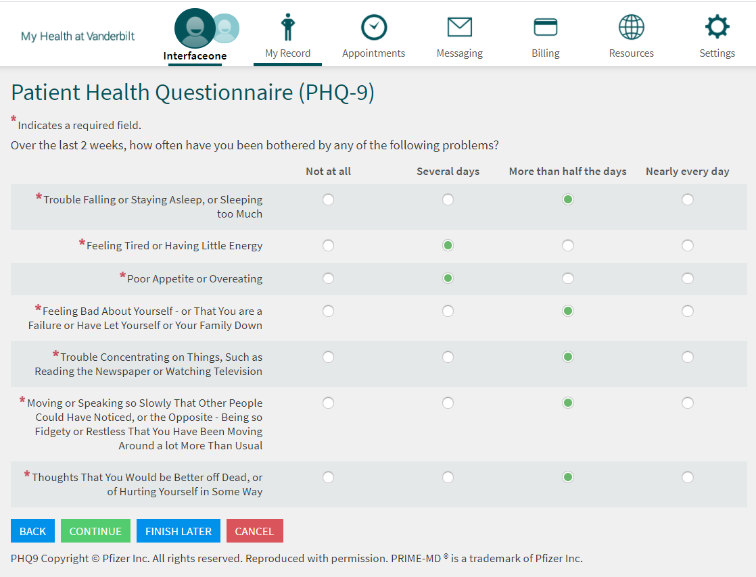
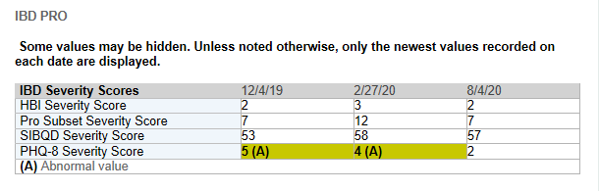
EMR Mental Health Assessment
Patient: Fill out prior to clinic
Provider: Automatically shows in Note
Courtesy of: Patient Reported Outcomes Team
Notes:
This is an example of a questionnaire view if they were using My Health at Vanderbilt on their own device prior to the visit.

Slide 9
Mental Health: Assessment
Several structural methods:
  Routine screening for mental health disorders
    Screen “positive”, referred to behavioral health
      Often requires “care coordinators”, access to referrals
  Integrated care model: Team Based Care
    Physical and behavioral health integral in initial evaluation
      Treatment plans based on team-based assessments
      Financial feasibility remains largest issue
Szigethy E, et al. Clinical Gastroenterol Hepatol 2017;15:986
Notes:
Several societies have started to try to help practitioners understand how this could be feasible in small or larger implementation strategies. For instance the American gastroenterological association recently published a white paper outlining several ways to do this within our current health care models in the US.
One relatively simple strategy is to first screen patients for mental health disorders. They suggested several options for evaluation including the patient health questionnaire or PHQ which is used within the VUMC system currently commonly and within our IBD clinic. Once a patient is found to be at risk, referral to behavioral health could be started. This however, can be complicated and require more resources and knowledge than many clinics have currently.
Another options is more resource intensive is an integrated care model where physical and behavioral health is integrated into the initial evaluation. Treatment plans are based on the team assessment. Obviously financial feasibility remains the largest obstacle as this has significant upfront cost.

Slide 10
Mental Health: Team Based Care
UPMC Medical Home
  n=322 pts
47% reduction in ED visits
35% reduction in hospitalizations
Improvements in disease activity, QOL, depression scores
Reguiero M, et al. Clinical Gastroenterol Hepatol 2018;16:1777
Notes:
They implemented this medical home initially as a pilot project and found that in 322 patients within their health system, they had a 47% reduction in ED visits and 35% reduction in hospitalizations even within a one year period. Also these patients had significant improvement in disease activity scores, quality of life scores and depression scores.

Slide 11
Mental Health: Team Based Care
Study Population: 608 pts with IBD from 3 tertiary care academic IBD centers with integrated care and specialty pharmacies prescribed self-injectable biologic therapies
Adherence: High Medication Possession Ratio (MPR) and Adherence Rates (68-70%) across centers
Outcomes: Non-adherence increased the likelihood of ED Visits and IBD-related hospitalizations in adjusted and unadjusted analysis
 | Center 1 n=460 | Center 2 n=81 | Center 3 n=67 | p value
MPR,mean (+/- SD) | 0.89 +/- 0.13 | 0.88 +/- 0.16 | 0.90 +/- 0.10 | NS
Adherent (MPR > 0.86) | 70% (323) | 68% (55) | 69% (46) | NS
15% higher than national average!

Slide 12
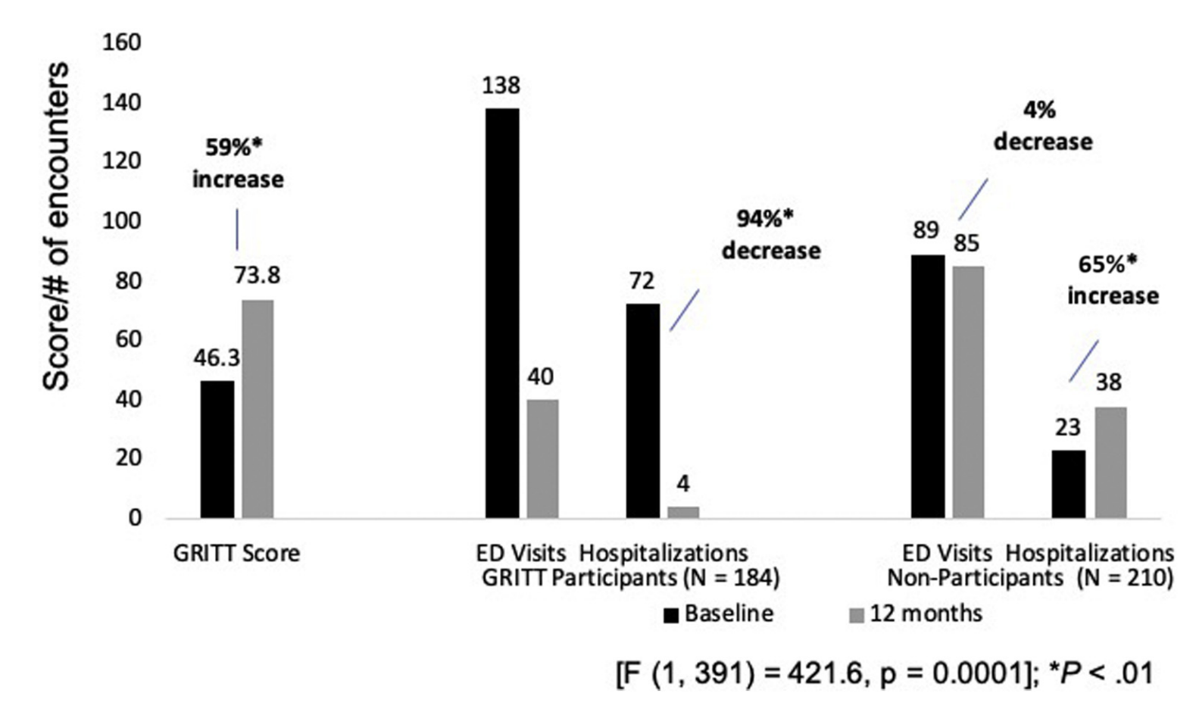
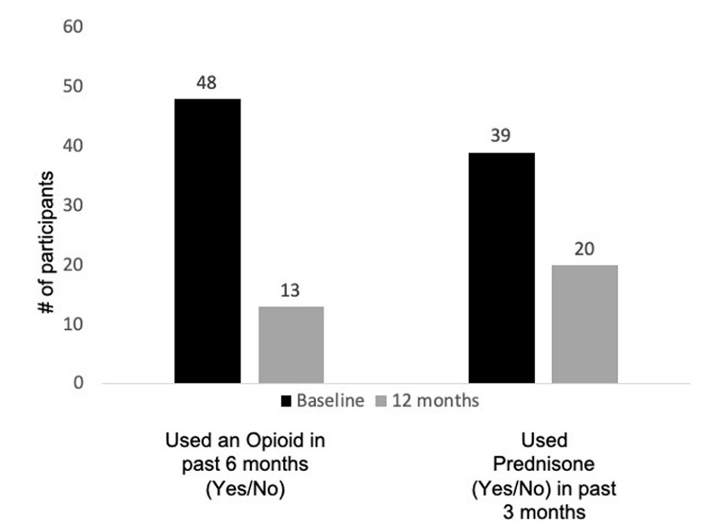
Mental Health: Team Based Care
Resilience based care coordination program
  Decreased ED Visits, Hospitalizations, Opioid Use, Prednisone Use
Keefer L, et al. Clin Gastroenterol Hepatol 2022;20:1831

Slide 13
Mental Health: Team Based Care
n=490 pts at IBD center in Australia, screened for mental health d/o
    55% (183) met criteria for risk for mental health disorder and offered treatment
      50% accepted: Most was CBT and Acceptance/Commitment therapy
Pts who accepted psychological intervention
  Improvements in Depression/Anxiety/QOL
  Less ED visits in the 12 months after intervention
  Cost saving analysis of integrated care model: Significant (++)
Lores T, et al. J Crohns Colitis 2019;819
Lores T, et al. Clinical Gastroenterol Hepatol 2021;19:96.
Notes:
Another center in Australia evaluated their integrated care model. Of 490 patients, all were screened for a mental health disorder and then were offered coordinated treatment within the center.55% met criteria and about ½ of those patients accepted treatment which included CBT or acceptance/commitment therapy. Those who participated had significant improvements in depression/anxiety and quality of life scores and also significantly less ED visits in the 12 months after the intervention. Integrating the cost of the behavioral health services, there was still cost savings in an analysis model.

Slide 14
Mental Health Care: Barriers
Barriers:
  Financial
  Availability
  Complexity
  Appropriate patient population
    Knowing how is at risk
  Stigma
  Lack of appropriate reimbursement models

Slide 15
Mental Health: How to overcome Barriers
Locators: GI Psychologists and General Mental Health Providers
  https://locator.apa.org/
  https://romegipsych.org/
  Web Based Patient Support and Education
  Important to find the correct Web Based support for individual patient
    Follow up!
  Self Management and Education: GI onDEMAND (https://giondemand.com/)
  Digital Therapeutics directed at GI conditions (some with cost involved):
      Trellus: Resilience Program for IBD
      Nerva: Gut-Directed Hypnotherapy
      Zemedy: Self-directed, CBT
      Mahana: CBT for IBS*
      Regulora: Gut-Directed Hypnotherapy for IBS*
*FDA Approved

Slide 16
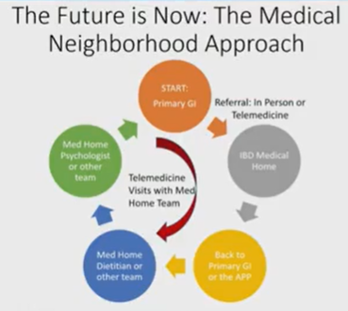

Mental Health: How to overcome Barriers
Regional Collaborative Care: “Medical Neighborhoods”
Example: Vanderbilt University IBD Medical Center: FY 2022: > 6,000 telehealth visits
  29% dietician/social work/psychologist

Slide 17
Conclusions
Psychiatric Comorbidities are increased in patients with IBD
  Lead to worse clinical outcomes
Mental Health Assessment is important and recommended
Mental Health treatment can improve outcomes
  Barriers are present
  Increasing options available

