Slide 1
Classification and Management of Pouch Disorders
Jami Kinnucan, MD
Director of Clinical Practice for the Division of Gastroenterology
Section of Gastroenterology and Hepatology
Mayo Clinic, Jacksonville, Florida
Edward L. Barnes, MD, MPH
Assistant Professor of Medicine
Division of Gastroenterology & Hepatology
University of North Carolina at Chapel Hill

Slide 2
The Role of Surgery in Ulcerative Colitis
An estimated 13-15% of patients with ulcerative colitis (UC) will require a colectomy within the first 10 years of diagnosis
Indications for Colectomy
Medically refractory disease
Acute perforation
Fulminant colitis
Acute hemorrhage
Colorectal dysplasia/neoplasia
Familial adenomatous polyposis
Frolkis AD, et al. Gastroenterology 2013;145:996-1006.
Tsai L, et al. Clin Gastroenterol Hepatol. 2021;10:2031-2045.
Hahnloser D, et al. Br J Surg 2007.
Diederen K, et al. Br J Surg 2017.1

Slide 3
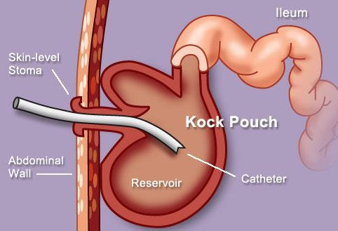
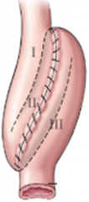
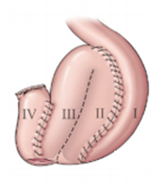
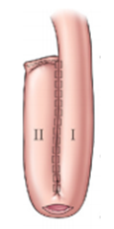
Ileal Reservoirs: the ABCs (or KSWJs)
K-Pouch
S-Pouch
W-Pouch
J-Pouch
Kock pouch or
continent ostomy
Ileal pouch anal anastomosis (IPAA)
Images adapted from Kirat and Remzi
Seminars in Colon and Rectal Surgery, June 2009
Notes:
The Kock pouch was first described in 1969 but was subsequently taken over by
Rstorative proctocolectomy with ileal pouch-anal anastomosis is preferred surgical approach after colectomy in ulcerative colitis
The earliest pouch created/described was the S-pouch.
However the S-pouch can reach additional 2-4cm and thus if concern for tension on the J-pouch could be considered. We will review endoscopic assessmen of the S-pouch later.
The W-pouch and S-pouch are hand sewn and more time consuming.
The J-pouch can be hand sewn or stapled (preferred)
A meta-analysis showed similar post-operative outcomes in S/W/J pouches, with J-pouches having higher stooling frequency and S/W having more difficulty with evacuation.

Slide 4
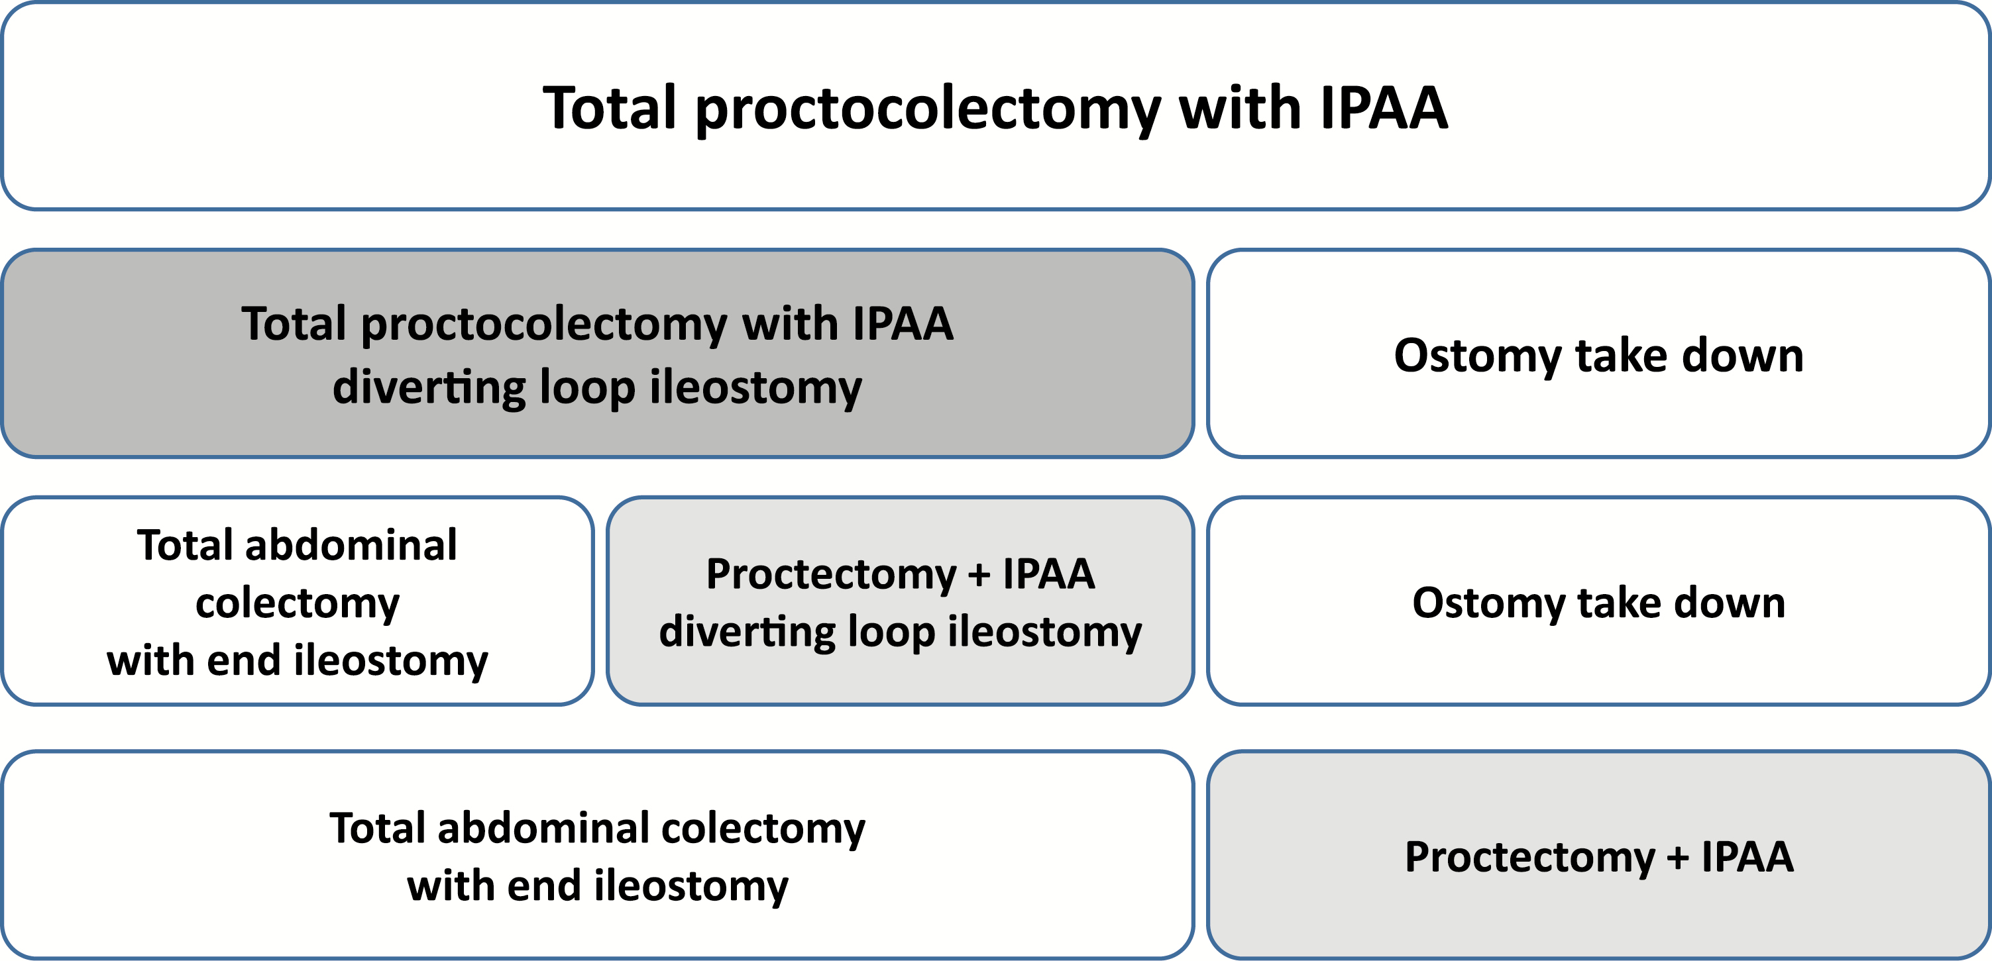
Stages in Pouch Surgery
1 Stage
2 Stage
3 Stage
Modified 2 Stage
Kochar B, et al. Inflamm Bowel Dis. 2018;24:1833-1839.
Quinn KE and Raffals LR. Am J Gastroenterol. 2020;115:1439-1450.

Slide 5
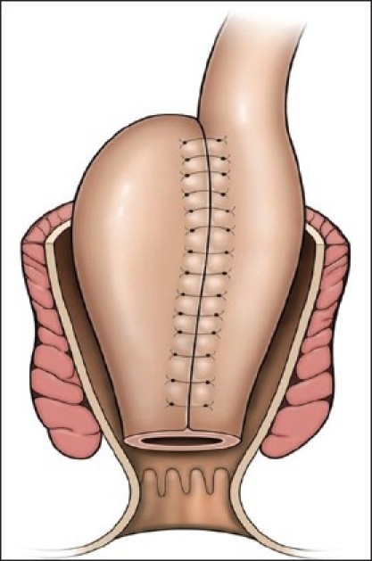
Basics of the J Pouch Anatomy
Tip of J-pouch
Afferent Limb
Pre-pouch ileum
Efferent limb
Pouch inlet
Pouch body
Distal anastomosis
Rectal cuff
Anal canal

Slide 6
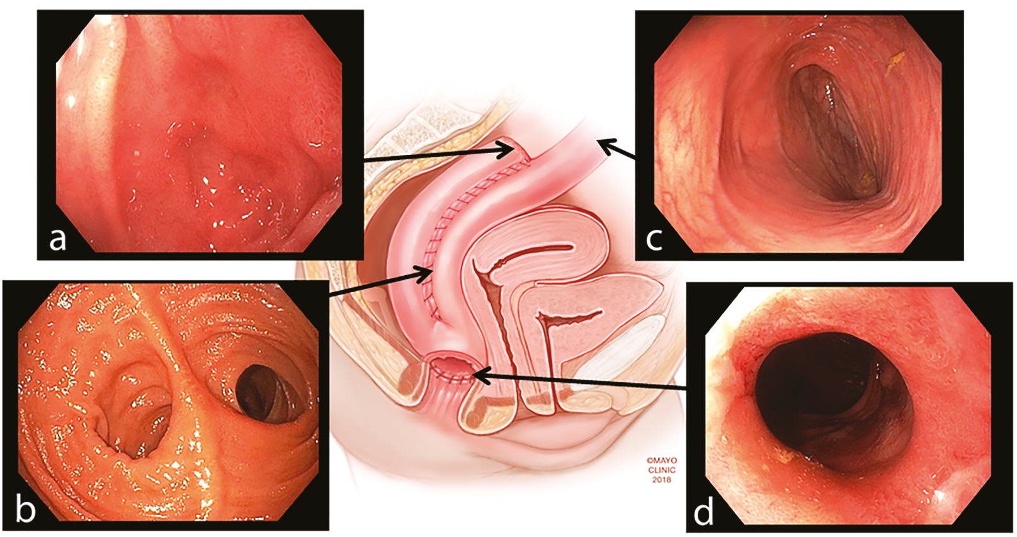
Landmarks and Anatomy
Tip of the J
Afferent limb
Owl’s eye appearance, pouch body
Anal transition zone
Quinn KP, et al. Inflamm Bowel Dis. 2019; 25(3):460-471.

Slide 7
Evaluation of the J Pouch
CBC, CMP, CRP, ESR
Iron studies
Vitamin D
Celiac serologies
ANA
AMA
IGG4
Stool infection eval
Stool cx/GIPCR
C. Difficile
CMV (histology)
Clinical assessment
Laboratory evaluation
Stool evaluation
Endoscopic evaluation
Imaging considerations
CTE/MRE
Pouchogram
Defecography
Anorectal manometry
EUS
EUA
Intestinal ultrasound

Slide 8
The Pouchitis Disease Activity Index
Clinical Criteria (max 6) | Score
Stool frequency Usual postoperative stool frequency 1-2 stools/day > postoperative 3+ or more stools/day > postoperative | 0 1 2
Rectal bleeding None/rare Daily | 0 1
Frequency urgency/abdominal cramps None Occasional Usual | 0 1 2
Fever >37.8 Absent Present | 0 1
Endoscopic Criteria (max 6) | Score
Edema Granularity Friability Loss of vascular pattern Mucous exudates Ulceration | 1 1 1 1 1 1
Pouchitis > 7
Total score 18
Histologic Criteria (max 6) | Score
Polymorphic nuclear leukocyte infiltration Mild Moderate + crypt abscess Severe + crypt abscess | 1 2 3
Ulceration >25% 25-50% >50% | 1 2 3
Sandborn, W et al. Mayo Clinic Proceedings 1994;69:409-415.

Slide 9
The modified Pouchitis Disease Activity Index
Clinical Criteria (max 6) | Score
Stool frequency Usual postoperative stool frequency 1-2 stools/day > postoperative 3+ or more stools/day > postoperative | 0 1 2
Rectal bleeding None/rare Daily | 0 1
Frequency urgency/abdominal cramps None Occasional Usual | 0 1 2
Fever >37.8 Absent Present | 0 1
Endoscopic Criteria (max 6) | Score
Edema Granularity Friability Loss of vascular pattern Mucous exudates Ulceration | 1 1 1 1 1 1
Pouchitis > 5
Sn 97%
Sp 100%
Shen, B et al. Dis Col Rec 2003

Slide 10
The Endoscopic Pouch Score
Segment Score
Modifiers
Improved agreement between independent reviewers
Endo PDAI
ICC 0.66 (0.52-0.79)
Endoscopic Pouch Score
ICC 0.83 (0.75-0.90)
Barnes EL, et al. Clin Gastroenterol Hepatol 2022; epublished May 12.

Slide 11
Diseases of the Pouch

Slide 12
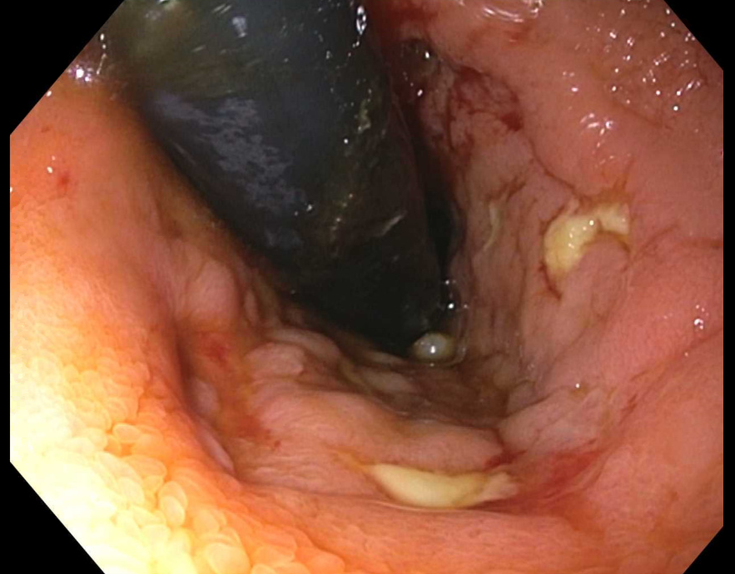
Cuffitis
Cuffitis is a residual effect of ulcerative colitis
  inflammation of the remaining anorectal tissue above the dentate line
  Typically a 1-2 cm area of rectal cuff/anal transition zone mucosa is present after stapled approach to IPAA
Cuffitis is more common in stapled anastomosis as compared to hand-sewn anastomosis (with mucosectomy of anal transition zone)
Traditional prevalence estimates of 10-13% of patients
May affect up to 30%-46% of patients after IPAA based on pouchoscopy data
Typically responds favorably to topical mesalamine therapy
Kayal M, et al. Inflamm Bowel Dis. 2020;26:1079-1086.
Shen B, et al. Am J Gastroenterol. 2004;99:1527-31.
Akiyama S, et al. Clinical Gastroenterol Hepatol. 2022; 20:293-302.
Notes:
30% within median 1 year (range up to 2.4 years follow up)

Slide 13
Overview of Pouchitis
Acute pouchitis
Antibiotic responsive
Pouchitis
Chronic antibiotic dependent (CADP)
Recurrent pouchitis
Chronic antibiotic resistant pouchitis (CARP)
↓ quality of life
Pouch failure
Shen B. Clin Gastroenterol Hepatol. 2013;11:1538-49.
Barnes EL, et al. Clin Gastroenterol. 2020;18:1356-1366.

Slide 14
Changing Incidence of Pouchitis Over Time
Barnes EL, et al. Clin Gastroenterol Hepatol 2023;21:192-199.
Notes:
Incidence ranged from 40% in earliest time period to 55% by 2015 to 2018 time period

Slide 15
Acute Pouchitis
Acute antibiotic responsive pouchitis: Infrequent episodes (<4 per year)
Typical symptoms:
  Frequency
  Urgency
  Incontinence
  Abdominal/pelvic cramping or pain
Shen B, Nat Rev Gastroenterol Hepatol. 2012;9:323-33.
Shen B. Clin Gastroenterol Hepatol. 2013;11:1538-49.
Barnes EL, et al. Clin Gastroenterol Hepatol. 2020;18:1356-1366.
Quinn KP, Raffals LE. Am J Gastroenterol. 2020;115:1439-1450.

Slide 16
Acute Pouchitis
The optimal antibiotic regimen for treating pouchitis is unknown
The typical approach utilizes a 14-day course of ciprofloxacin or metronidazole
Ciprofloxacin may be associated with a greater response, with less adverse effects
Nguyen N, et al. Cochrane Database Syst Rev. 2019;5:Cd001176.
Shen B, et al. Inflamm Bowel Dis. 2001;7:301-5.
Notes:
Prompt initiation of antibiotics resolves pouchitis symptoms in most patients

Slide 17
Chronic Pouchitis
Chronic pouchitis affects 17-19% of patients
Chronic antibiotic dependent pouchitis (CADP)
  Multiple pouchitis episodes per year (>4)
  Symptoms are controlled on antibiotics, but worsen when antibiotics are discontinued
Chronic antibiotic refractory pouchitis (CARP)
  Clinical definition based on lack of response to normal antibiotic regimens
  May require immunosuppression, such as biologics
Shen B, Nat Rev Gastroenterol Hepatol. 2012;9:323-33.
Fazio V, et al. Ann Surg 2013;257: 679–685.
Shen B. Clin Gastroenterol Hepatol. 2013;11:1538-49.

Slide 18
Vedolizumab: The EARNEST Trial
.
Travis S, et al. J Crohns Colitis. 2022;OP04.

Slide 19
Potential Treatment Options in Pouchitis
Agent | Data | Types
Antibiotics | Acute pouchitis + Chronic pouchitis + | Metronidazole 20 mg/kg/day Ciprofloxacin 500 mg BID Augmentin 875-125 mg BID Erythromycin Tetracycline | Rifaximin Metronidazole + Flagyl Ertapenam* Vancomycin*
Probiotics | Prophylaxis + Maintenance + | Visbiome (formerly VSL#3) E. coli Nissle 1917
Mesalamine | +/- | Oral mesalamine/sulfasalazine | Mesalamine enema
Oral steroids | +/- | Oral corticosteroid/budesonide | Corticosteroid enema
Immunomodulator | +/- | azathioprine
Biologic | +/- | Infliximab Vedolizumab | Ustekinumab
Other | +/- | Hyperbaric O2 Fecal transplant | Green tea extract

Slide 20
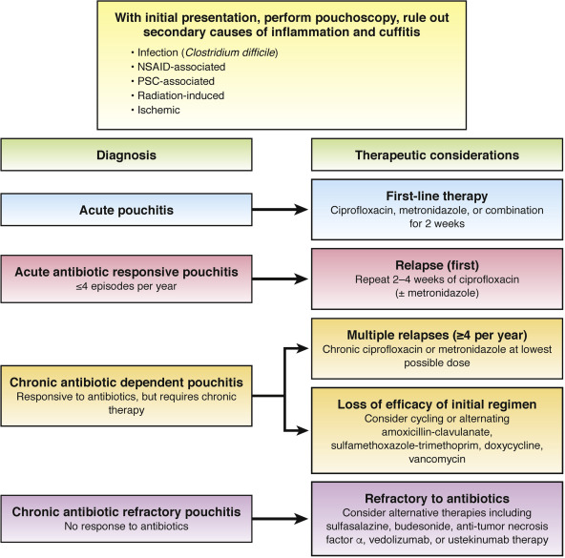
Approach to the Patient with Suspected Inflammation after IPAA
Barnes EL, et al. Clin Gastreonterol Hepatol. 2020;18:1356-1366.

Slide 21
Crohn’s-like Disease of the Pouch
Occurs in approximately 10% of patients undergoing colectomy with IPAA for ulcerative colitis
Characterized by fistulae development, pouch and afferent limb strictures, and pre-pouch ileitis
Barnes EL, et al. Inflamm Bowel Dis. 2019; 25(9):1474-80.

Slide 22
Efficacy of Biologic Therapy for Crohn’s-like Disease of the Pouch
Anti-TNF Therapy: systematic review and meta-analysis
  Rate of short-term clinical remission: 0.64 (0.50 – 0.77)
  Rate of long-term clinical remission: 0.57 (0.43– 0.71)
Vedolizumab: Multicenter study from 5 academic IBD centers
  71% clinical response
  19% clinical remission
  36% discontinued vedolizumab
  60% continued antibiotics
Ustekinumab: Multicenter study from 4 academic IBD centers
  83% clinical response (6 months after induction)
  Responders demonstrated significantly less pouch inflammation compared with non-responders (29% vs. 100%, p=0.023)
Huguet M, et al. Inflamm Bowel Dis. 2018;24:261-8.
Gregory M, et al. Inflamm Bowel Dis. 2019;1569-1576.
Weaver KN, et al. Inflamm Bowel Dis. 2019;25:767-774.
Notes:
Paucity of data for JAK inhibitors

Slide 23
Clinical Remission at 6 months after enrollment (CD pouch)
Barnes EL, et al. Crohn’s Colitis 360. In press.

Slide 24
Summary
IPAA is preferred surgery after colectomy in patients with IBD
Up to 48% of patients will develop acute pouchitis within the first 2 years of surgery
Endoscopic assessment is an important tool in evaluation
Acute pouchitis- most patients will respond to antibiotics
No currently approved treatments for chronic antibiotic refractory pouchitis
Important to standardize approach to these patients which includes diagnostic evaluation/documentation

