Slide 1
Medical Managementof Perianal Crohn’s Disease
David A. Schwartz, MD, FACG, AGAF Director, McClain Family Directorship in Gastroenterology Director, Inflammatory Bowel Disease Center Professor of Medicine Vanderbilt University Medical Center

Slide 2
Epidemiology / Morbidity

Slide 3
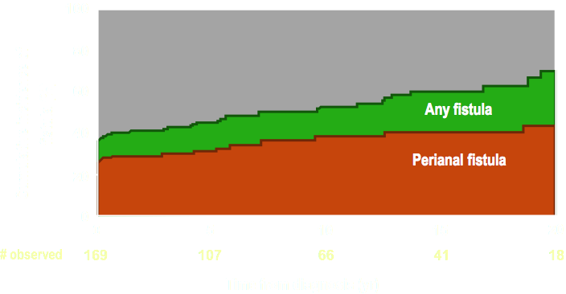
Cumulative Incidence of Crohn’s Fistulas
Rate of PCD decreased in recent cohort > 1998 to 14.5 %
Schwartz et al, Gastro 2002
Park et al., IBD 2019

Slide 4
Durable Fistula Healing Rates are Disappointing
Retrospective study from Leiden of 232 patients with CD fistulas - ~ 10 years followup
78% had complex fistulas
Long –term fistula healing was seen in only 37% of patients with complex fistulas
66.7 % of simple fistulas
53 % of patients required surgery (colectomy, etc)
Proctectomy Rate in recent Mayo cohort was largely unchanged at 19%
Molendijk et al. IBD 2014
Park et al., IBD 2019

Slide 5
PCD is Associated with Increased Costs
All-cause Healthcare Costs P < 0.0001 for all comparisons, PAF CD vs non-PAF CD
GI-related Healthcare Costs P < 0.0001 for all comparisons, PAF CD vs non-PAF CD
$85,233
$71,612
$40,526
$29,458
2,138
Schwartz et al, 2020

Slide 6
Approach to Initial Diagnosis and Assessment

Slide 7
What Happens When Fistulas are Missed at Time of EUA?
-In 52% of patients needed repeat surgery in cases where surgery and MRI disagreed
-Fistula recurrence was always at site predicted by MRI
Buchanan et al, Lancet 2002

Slide 8
Study Results
A prospective triple blinded study compared EUS, MRI and EUA in 32 patients with suspect perianal Crohn’s disease.¹
All three methods showed excellent accuracy in assessing these patients
EUS – 91% (95% CI 75% - 98%)
EUA – 91% (95% CI 75% - 98%)
MRI – 87% (95% CI 69% - 96%)
Combining either of the imaging modalities with EUA increased the accuracy to 100%
1- Schwartz et al., Gastro 2001

Slide 9
Options for Therapy

Slide 10
Medical Therapies
Antibiotics (metronidazole, ciprofloxacin)
Immunosuppressives
Azathioprine
6-mercaptopurine
Cyclosporine
Tacrolimus
Biologic Agents
Infliximab
Adalimumab
Certolizumab
Vedolizumab ?
Ustekinumab?
Novel Agents
Adipose Derive Stem Cells

Slide 11
Antibiotics

Slide 12
Antibiotics Improve Fistula healing in Combination with Anti-TNF Therapy
N=76
All patients received adalimumab 160 mg at wk 0, 80 mg at wk 2 and then 40 mg qow. Patients were then randomized to Ciprofloxacin 500 mg bid or placebo.
Dewint P, et al. Gut 2013.
Notes:
Dewint P, Hansen BE, Verhey E, Oldenburg B, Daniel W. Hommes, Marie J. Pierik, Cyriel Ponsioen, Hendrik M. van Dullemen, Maurice G. Russel, Adriaan A. van Bodegraven, Christien J. van der Woude et al. Adding Ciprofloxacin to Adalimumab Results in a Higher Fistula Closure Rate in Perianal Fistulizing Crohn's Disease. Gastroenterology 2012 Vol. 142, Issue 5, Supplement 1, Page S-212.
AddingCiprofloxacintoAdalimumabResultsinaHigherFistulaClosureRateinPerianalFistulizingCrohn'sDiseasePieterDewint,BettinaE.Hansen,ElkeVerhey,BasOldenburg,DanielW.Hommes,MarieJ.Pierik,CyrielPonsioen,HendrikM.vanDullemen,MauriceG.Russel,AdriaanA.vanBodegraven,ChristienJ.vanderWoudeBACKGROUND:Bothanti-TNFagentsandantibioticshaveshowntheirefficacyfortheclosureofperianalCrohn'sfistulas.Theexistenceofanadditiveeffectofcombinationtherapyforfistulaclosureremainstobedemonstrated.METHODS:Amulticenter,double-blind,placebocontrolledtrialwasconducted,evaluatingadalimumabincombinationwithcipro-floxacinorplacebointhetreatmentofactivefistulizing,perianaldiseaseinCrohn'sdiseasepatients(ADAFI).Seventy-sixpatientswereenrolledandreceivedinductiontherapywithadalimumabsubcutaneously(160mgonweek0,80mgonweek2),followedbymaintenancetherapy(40mgeveryotherweek)togetherwithplaceboorciprofloxacin500mgtwicedailyfor12weeks,dependingontherandomizationarm.Theanalyseswerebasedonthemodifiedintention-to-treatpopulationafterexclusionof4patientswithspontaneousfistulaclosurebeforestudystartand2patientsinwhomperianaldrainswereleftinsitu.Theprimaryendpointwasclinicalresponse,definedasareductionof≥50%ofthenumberofdrainingperianalfistulasfrombaselinetoweek12.Patientsnotevaluatedatthesheduledtimepointswerecodedasnon-responders.SecondaryendpointswerechangeinPerianalCrohn'sDiseaseActivityIndex(PDAI)frombaselineandinductionofremissionofCrohn'sdiseasebasedonCrohn'sDiseaseActivityIndex(CDAI).RESULTS:Seventeen(47,2%)of36patientsassignedtoadalimumabplusplaceboand24(70,6%)of34assignedtoadalimumabincombinationwithciprofloxacinshowedclinicalresponseatweek12(p=0.047).Atweek24,nosignificantdifferencebetweenthe2groups(17/36resp21/34)couldbewithheld(p=0.22).Theoverall,medianPDAIatweek12andweek24(medianPDAI=3resp3)wassignificantlylowerthanatbaseline(medianPDAI=7)(p<0.001).However,comparingthe2treatmentarms,nosignificantdifferenceinthechangeofPDAIfrombaselinecouldbedetectedatweek12noratweek24(p=0.16respp=0.32).CombinationtherapywithciprofloxacinwasmoresuccessfulthanadalimumabaloneatinducingremissionofCrohn'sdisease(CDAI<150)atweek12(68.8%vs26.7%,p=0.02).Intotal,24(34,3%)of70patientshadpreviouslyreceivedinfliximab.Thisdidnotinfluenceperianalfistularesponseratetotreatmentwithadalimumab,comparedtopatientsnaivetoinfliximab(62.5%resp56.5%(p=0.63)).CONCLUSION:FortheinductionofperianalfistulaclosureinCrohn'sDisease,combinationtherapyofadalimumabandciprofloxacinishighlyeffectiveandcanbeadvocatedoveradalimumabalone.Afterdiscontinuationofantibiotictherapy,theinitialbeneficialeffectofco-administrationonfistulaclosurerateisnotmaintained.Previoustreatmentwithinfliximabdoesnotinfluencethepotencyofadalimumabtoinduceperianalfistulaclosure.

Slide 13
Azathioprine / 6 - MP

Slide 14
Azathioprine / 6 - MP
The 5 Controlled trials were summarized in a meta-analysis¹
22 / 41 (54%) of patients who received AZA /6-MP responded vs. 6 / 29 (21%) who received placebo.
Pooled odds ratio was 4.44 in favor of fistula healing
1-Pearson et al. Ann Intern Med. 1995

Slide 15
Cyclosporine &
Tacrolimus (FK-506)

Slide 16
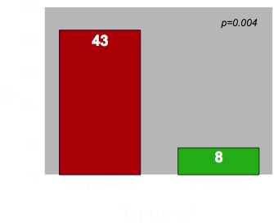
Tacrolimus (FK-506)
The double blinded placebo study of 48 patients randomized to receive 0.20mg/kg/day for 10 weeks. Primary endpoint was improvement defined as closure of ≥ 50% fistulas and maintenance of closure for ≥ 4 weeks.
Week 10 Results
Only 10% had closure of all fistulas
Sandborn et al. , Gastro 2003

Slide 17
Anti-TNF α Antibody

Slide 18
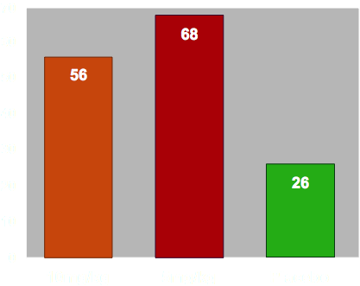
Infliximab for Crohn’s Perianal Fistulas
Primary endpoint; > 50% reduction in open fistulas
Initial Fistula Response to Infliximab
N=94
%
p = 0.041
p < 0.001
Present et al. , NEJM 1999

Slide 19
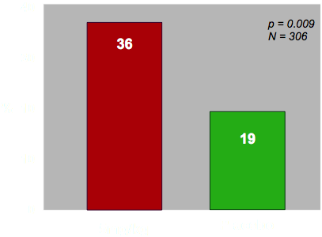
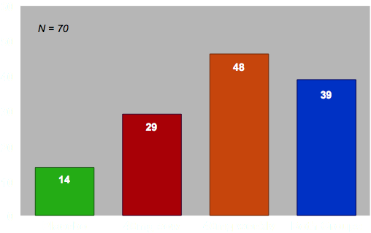
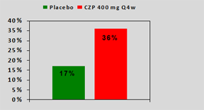
Anti-TNF Maintenance Therapy for CD Related Fistulas
Infliximab
Adalimumab
Certolizumab
N=28
1-Sands et al. , NEJM 2004
2-Colombel, Gut 2009
3- Schreiber S, et al. APT, 2011

Slide 20
Anti-TNF Levels and Fistula Healing
Clinical Assessment
MRI Assessment
N=193 (117=IFX)
DE Gregorio et al. Clin Gastro and Hep, 2021

Slide 21
The Use of Imaging to Guide Therapy

Slide 22
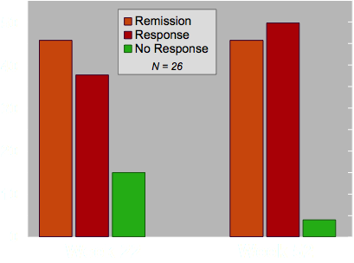
MRI to Guide Therapy with Infliximab or Adalimumab
Medical therapy was increased if no or partial response seen on MRI
Ng et al. Am J Gastro 2009

Slide 23
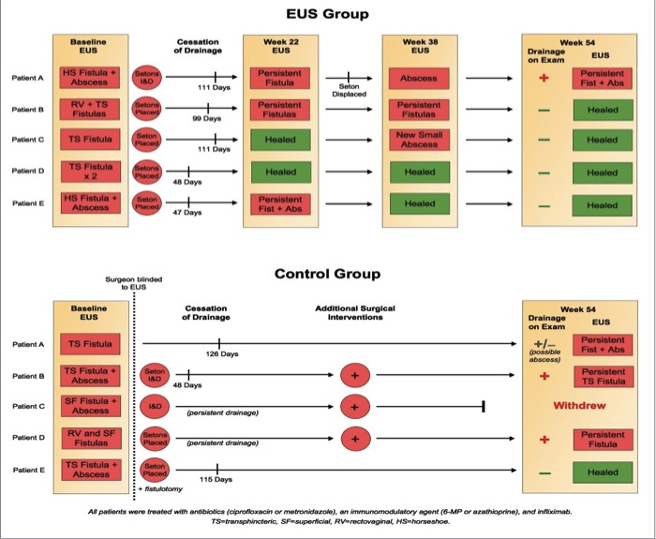
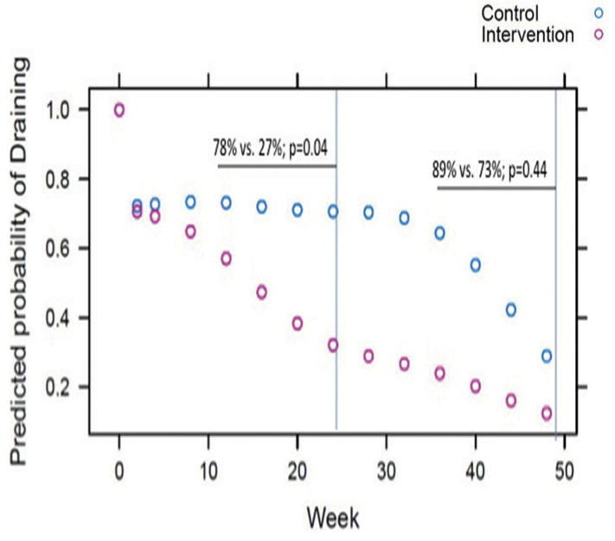
Two Randomized Prospective Studies Looking at EUS to Improve Outcomes
Initial Prospective Pilot Study
Follow-up Prospective Study
1-Spradlin, Schwartz Am J Gatro 2008
2- Wiese,Schwartz IBD 2015

Slide 24
Future Options ?

Slide 25
Post Hoc Analysis Suggests Ustekinumab Effective for Perianal Disease in Crohn’s
Fistula Resolution at Week 8 - Pooled Data from CERTIFI, UNITI-1 and UNITI-2
In large retrospective cohort (207 pts)- fistula healing was 39% at 6 months
Optimization to trough > 4.5 at week 26 was associated with better healing rates
Sands, DDW 2017
Battat R. Gastro 2017
Chapuis-Biron et al. Am J gastro 2020

Slide 26
Enterprise- Vedolizumab for CD Perianal Fistulas
Schwartz et al. DDW 2020

