Slide 1
IBD Roadmap: Fertility and Pregnancy in Inflammatory Bowel Disease
Sonia Friedman MD
Professor of Medicine
Tufts University School of Medicine
Chief of Gastroenterology
Tufts Medical School
Boston MA

Slide 2

IBD and Reproduction
Father with IBD
Pregnancy loss/ ectopic¹ pregnancy/elective abortion²
Effects of:
Disease activity
Medications
Surgery
Depression
Hypogonadism
Effects of:
Disease flare
Medications
Surgery
Ovarian reserve
Voluntary
childlessness
Viable intrauterine pregnancy
Mother with IBD
Sexual function
Fertility
Pregnancy
Conception
¹de Silva P et al. Clin Gastroenterol Hepatol. 2018; 16(1):83-89; ²Nørgård BM et al. Inflammatory Bowel Diseases. 2018
Notes:
Is is debated whether ………….fertily is decread in women and men with IBD, it is debated Medicinsk behandling – forskellige typer af medicinske præparater, varierende dosering af medicin, forskellige kombination af medicinsk behandling

Slide 3
Factors that might contribute to voluntary childlessness
Fear of inheritance
No desire for a child
Fear of IBD activity
Sexual dysfunction
Lack of appropriate family structure
Social circumstances
Fear of medications
Women with IBD are significantly more likely to remain voluntarily childless compared to the general population (17% versus 6%)^{1,2}
¹Nguyen et al., Gastro 2016, ²Selinger et al., JCC 2016.

Slide 4
Sexual dysfunction
IBD surgery
Uterine receptivity
Disease activity
Former
reproductive
history
Fertility in IBD
IBD medications
Low ovarian reserve
Abnormal sex hormone levels
Lifestyle factors
Women who want to become pregnant: Impact of IBD on fertility

Slide 5
Measuring fertility in IBD
Swedish National register: UC, CD, IBD-U
Fertility = the number of babies born
Contraceptive use after 2005
27,331 women (12 237 with UC, 8672 with CD and 6422 with IBD-U). Matched cohort [5:1] included 131 892 women
Fertility reduced in CD cohort (HR 0.88, 95% confidence interval [CI] 0.85–0.91), IBD-U cohort (HR 0.86, 95% CI 0.83–0.89) but only marginally reduced in UC cohort (HR 0.96, 95% CI 0.93–0.98)
Reduced fertility associated with: hospital admissions, increasing number of bowel resections and perianal disease
Druvefors. JCC 2021

Slide 6
Time to pregnancy in women with and without IBD
Friedman et al., Clinical Gastroenterology and Hepatology 2019.

Slide 7
Time to pregnancy is longer in women with Crohn’s disease and Crohn’s disease surgery

Slide 8
Ovarian reserve in Crohn’s disease
  Definition: The capacity of the ovary to provide egg cells that are capable of fertilization resulting in a healthy and successful pregnancy.
  Measurement: anti-Mullerian hormone (AMH) is a good indicator of ovarian reserve
  Low ovarian reserve in CD associated with:
  Age >30y¹
  Colonic disease¹
  Higher disease activity²
  Disease duration >5y²
  Surgery did not affect ovarian reserve²
  AMH level of women with CD or UC of reproductive age was significantly lower than that of healthy women³
  AMH level of women with CD or UC of reproductive age in remission was lower than that of healthy women³
¹Freour, Inflamm Bowel Dis 2012; ²Senates, J Crohns Colitis 2013; ³Guo et al, Medicine 2023.
Notes:
Retrospective study of 50 CD patients in remission compared to age-matched controls in France¹
Prospective study of 35 CD patients compared to age-matched controls in Turkey²

Slide 9
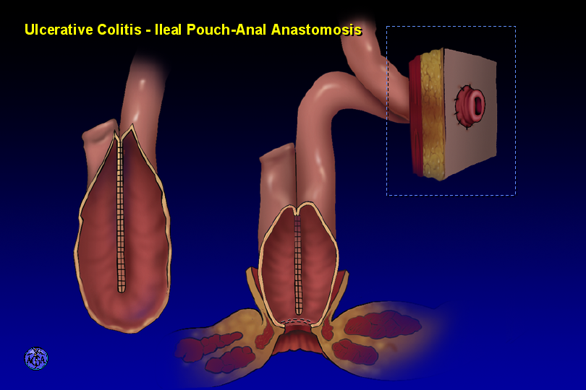
Post-surgical conception
Fertility is decreased three-fold after ileoanal pouch anastomosis (IPAA)¹.
Fertility is greatly improved with laparoscopic IPAA^{2,3}.
Fertility is decreased after proctectomy, but studies are lacking.
¹Waljee et al., Gut 2006; ²Bartels et al., Ann Surgery 2012; ³Beyer-Berjot et al., Ann Surgery 2013;

Slide 10
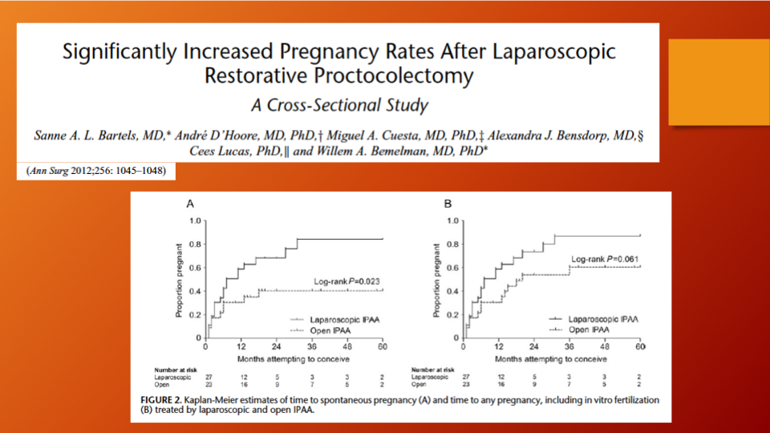
Fertility after laparoscopic IPAA

Slide 11
Post-surgical conception and assisted reproductive technology (ART): clinical practice
Discuss issue of fertility with patients contemplating surgery but emphasize that there are good outcomes with laparoscopy and ART if needed.
NEVER withhold needed surgery based on fear of infertility^{1,2,3}
Criteria for ART referral include failure to conceive for:
  >1 year in any IBD patient
  Any post surgical IBD patient with irregular cycles
  >3 cycles in a post surgical patient (proctectomy + ostomy or IPAA)
¹Cornish et al., Dis Colon Rectum 2007; ²Rajartnam et al., Int J Colorectal Dis 2011; ³Wikland et al., Int J Colorectal Dis 1990.

Slide 12
ART in women with IBD: Denmark studies
Live birth per embryo transfer in UC women
 | Exposed cohort (embryo transfers in women with UC) N = 1360 | Unexposed cohort (embryo transfers in non-IBD women) N = 148,540 | Crude OR 95% CI | Adjusted OR 95% CI | Adjusted OR 95% CI
Live birth Yes, N (%) No, N (%) | 272 (20.00) 1088 (80.00) | 35,321 (23.78) 113,219 (76.22) | 0.79 (0.67 -0.92) | 0.78 (0.67-0.91) | 0.73 (0.58-0.92)
Nørgård BM et al. Gut. 2016;65(5):767-76.

Slide 13
ART in women with IBD: Denmark studies
Live birth per embryo transfer in CD women
 | Exposed cohort (embryo transfers in women with CD) N = 554 | Unexposed cohort (embryo transfers in non-IBD women) N =148,540 | Crude OR 95% CI | Adjusted OR 95% CI | Adjusted OR 95% CI
Live birth Yes, N (%) No, N (%) | 94 (16.97) 460 (83.03) | 35,321 (23.78) 113,219 (76.22) | 0.62 (0.48-0.80) | 0.61 (0.47-0.79) | 0.77 (0.52-1.14)

Slide 14
Surgery for CD decreases live births per embryo transfer
 | Exposed cohort (embryo transfers in CD women who had prior surgery) N= 355 | Unexposed cohort (embryo transfers in CD women who had no prior surgery) N = 199 | Crude OR 95% CI | Adjusted OR¹ 95% CI
Live birth Yes, N (%) No, N (%) | 50 (14.08) 305 (85.92) | 44 (22.11) 155 (77.89) | 0.56 (0.33-0.93) | 0.51 (0.29-0.91)

Slide 15
The failure to achieve a live birth is a failure to achieve a clinical pregnancy
  Why?
  IVF technique?
  Subclinical disease?
  Microbiome changes?
  Autoimmunity?
  IBD Medications?
  Differences in reproductive hormones?
What implications does this have for all women with IBD wishing to have children?

Slide 16
Preconception care: IBD clinical practice
All IBD patients should see a maternal fetal medicine specialist
Goals of care^{1,2,3}:
  Confirm patient is in remission
  Discontinue teratogenic medications (including methotrexate)
  Folic acid and iron supplementation
  Optimize management of comorbidities
  Discuss previous obstetric history
  Update immunizations
  Screen for substance use, counsel smoking and alcohol cessation
Discussion and education regarding:
  Safety of most IBD medications during pregnancy and lactation
  Need to be in remission and avoid active IBD during pregnancy
  Optimal mode of delivery
¹Nguyen et al., Gastro 2016; ²van der Woude JCC 2015; ³Palomba et al., World J Gastroenterol 2014

Slide 17
Impact of pregnancy on maternal IBD
 | IBD (ulcerative colitis and Crohn’s disease)
 | % patients in remission during pregnancy | % patients with aggravated or persistent disease activity during pregnancy
Remission at the time of conception | 70 | 30
Active disease at the time of conception | 30 | 70
Heetun ZS. Reproduction in patients with inflammatory bowel disease. Aliment Pharmacol Ther 2007; 26: 513-533
Palomba S. Inflammatory bowel disease and human reproduction: a comprehensive evidence-based review. World J Gastroenterol 2014; 20: 7123-7136
Van der Woude J. European evidenced-based consensus on reproduction in inflammatory bowel disease. Journal of Crohn’s and Colitis 2010; 4: 493-510
Woude et al. The second European evidenced-based consensus on reproduction and pregnancy in inflammatory bowel disease. Journal of Crohn’s and Colitis 2015, 107-124

Slide 18
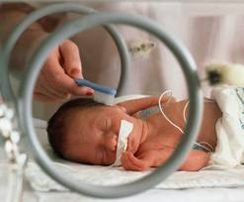
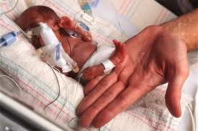
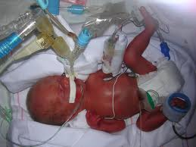
Preventing possible adverse outcomes
  Low birth weight and preterm birth are the main predictors for perinatal mortality and morbidity
  Impaired intrauterine growth predicts chronic diseases in adulthood
Notes:
Prenatal care is very important in patients with IBD in order to prevent adverse outcomes such as low birth weight and premature birth

Slide 19
Preconception care leads to less disease relapse during pregnancy
Prospective study; 2008-2013
Females of reproductive age with IBD attending IBD Pregnancy Outpatient Clinic (POC)
Study group (n=149): preconception IBD POC counseling (30-minute consult)
Control group (n=105): patients attending IBD POC when already pregnant
Results:
N= 254 | Control group (105) | Study group (149) | Better
Folate intake | 46 | 87 | X
Smoking cessation | 1 | 19 | X
Discontinuation of IBD meds due to concerns of side effects | 8 | 0 | X
Periconceptual disease activity | 16 | 12
Disease activity during pregnancy | 34 | 20 | X
  de Lima et al., Clin Gastro Hepatol 2016
Notes:
Su1351
Preconception Care in IBD Women Leads to Less Disease Relapses During Pregnancy
Alison de Lima, Zuzana Zelinkova, Cokkie van der Ent, Christien J. van der Woude
Background Preconception care is important for all women with a reproductive wish. Preconception care in IBD patients
(pts) is besides health promotion and risk behavior reduction also important to increase knowledge on the effects of IBD
and drugs on pregnancy outcomes. We assessed whether preconceptional care in IBD pts affects pregnancy outcome.
Methods From 2008 till 2013, all pts visiting the preconception and pregnancy outpatient clinic (POC) were prospectively
followed. For the purpose of this study we compared pts who received preconception care prior to pregnancy (study
group), to pts visiting the POC when already pregnant (control group). Patient characteristics, disease,-and obstetric history
and medication were documented. Number of relapses, folate intake, medication changes, smoking behaviour and pregnancy
outcomes were noted. Results In the study group (76 CD, 25 UC, 6 IBDU), 107 out of 152 pts got pregnant, resulting
in 82 live births, 16 miscarriages, 1 stillbirth and 8 still pregnant at time of analysis. In the control group (71 CD, 30 UC,
2 IBDU), 103 pregnancies resulted in 82 live births, 9 miscarriages, 1 stillbirth, 1 elective abortion, 8 still pregnant at
time of analysis and 2 lost to follow-up. The groups were comparable in terms of marital status (p=0.898), education level
(p=0.265), smoking 3 months before pregnancy (p=0.498), 5-ASA use (p=0.1244), corticosteroids use during pregnancy
(p=0.1543) and previous bowel surgery (p=0.329). Pts in the study group were more often nulliparous (p=0.007) and
more often used thiopurines (p=0.0011) and anti-TNF (p=0.0001) during pregnancy. Compared to the control group, pts
in the study group more often used folate (44 vs 99, p=0.0005) and more often quit smoking during pregnancy (3 vs 13
p=0.0013). In the control group, 8 pts discontinued IBD medication due to fear of side effects on the child, which lead
to disease relapse in 1 pt. In the study group, none of the pts discontinued IBD medication at own initiative. Preconception
care had a protective effect on disease activity during pregnancy, independent of smoking status, disease duration and
peri-conceptional disease activity (Crude OR= 0.441 95% CI: 0.232-0.838, Adjusted OR= 0.455 95%CI: 0.211-0.979).
Conclusion Preconception care in IBD women is associated with smoking cessation, folate intake and adequate intake of
IBD medication during pregnancy and prevents disease relapse.

Slide 20
Predictors of disease activity during pregnancy in women with IBD
Aarhus University, Denmark
Physician’s global assessment - escalation in medical treatment, clinical disease scores, biomarker(s) of inflammation
  Preconception, conception each trimester
378 women, 609 pregnancies
Predictors of disease activity:
  Disease activity in previous pregnancy aOR of 3.2 [1.5–6.6]; p = 0.002.
  Preconception disease activity aOR of 5.3 [3.5–8.2]; p < 0.001
  UC phenotype aOR = 2.6 [1.8–3.9]; p < 0.001.
Consequences of disease activity:
  Lower birth weight when compared to women who were in remission throughout pregnancy, higher prevalence of CS and fetal growth restriction
Vestergaard. APT 2023

Slide 21

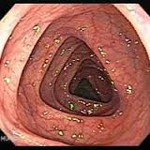

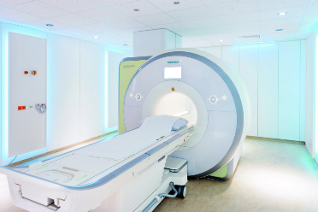
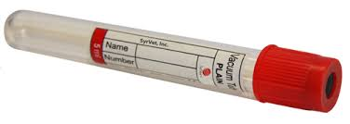
How do we evaluate disease activity during pregnancy?
www.flickr.com
www.photobucket.com
www.beliefnet.com
www.syrvet.com
www.active8health.net

Slide 22
Management of the flaring IBD pregnant patient
Medication choices are similar
  Avoid new aza/6mp in pregnancy
  OK to start prednisone for flares
  Okay to start biologics
  Avoid metronidazole in first trimester (T1)
Laboratory/Stool Tests
  C. difficile
  Fecal calprotectin (CRP, ALB, HGB are useless)
Imaging
  MRI preferred to CT, though no IV contrast
  Ultrasound
Endoscopy: Flexible sigmoidoscopy with no sedation
Surgery: Indications similar to non-pregnant patient; 2nd trimester best

