Slide 1
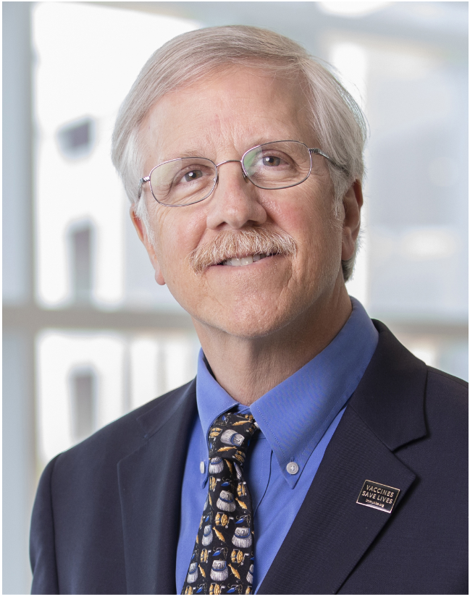
Non-Vaccine Health Maintenance Tasks
Francis A. Farraye, MD, MSc
Division of Gastroenterology and Hepatology
Director, Inflammatory Bowel Disease Center
Professor of Medicine
Mayo Clinic, Jacksonville, FL
farraye.francis@mayo.edu
@FarrayeIBD
May 2023

Slide 2
Disclosures
Consulting Fee: BMS, Braintree Labs, GI Reviewers, GSK,IBD Educational Group, Iterative Health, Janssen, Pharmacosmos, Pfizer, Sebela
DSMB: Adiso Therapeutics, Lilly
Research Support to Mayo: BMS, Creatics, Janssen, Takeda

Slide 3
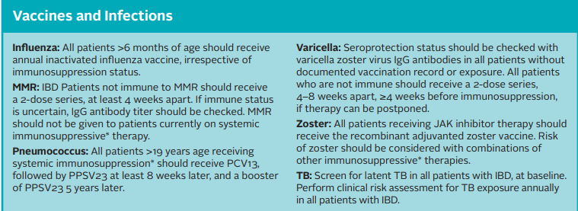
Health Maintenance Checklist for Adult Patients with IBD
Crohn’s & Colitis Foundation. Accessed 2/18/2023. https://www.crohnscolitisfoundation.org/sites/default/files/2019-09/Health%20Maintenance%20Checklist%202019-3.pdf.

Slide 4
Cancer Screening
Crohn’s & Colitis Foundation. Accessed 2/18/2023. https://www.crohnscolitisfoundation.org/sites/default/files/2019-09/Health%20Maintenance%20Checklist%202019-3.pdf.

Slide 5
Cancer Screening
Crohn’s & Colitis Foundation. Accessed 2/18/2023. https://www.crohnscolitisfoundation.org/sites/default/files/2019-09/Health%20Maintenance%20Checklist%202019-3.pdf.

Slide 6
Colorectal Cancer Screening
CRC screening should start 8 years after onset of disease symptoms except in patients with PSC
Murthy SK, et al. Gastroenterology 2021;161:1043–1051.
Notes:
The risk is time dependent, typically >6m use, and the risk while decreases with cessation of therapy to near baseline risk.
Some data have shown that IBD patients have slight increased risk for ALL skin cancers compared to general population.

Slide 7
Cancer Screening
Crohn’s & Colitis Foundation. Accessed 2/18/2023. https://www.crohnscolitisfoundation.org/sites/default/files/2019-09/Health%20Maintenance%20Checklist%202019-3.pdf.

Slide 8
Cancer Screening
Women with IBD on immunosuppressive therapy (especially thiopurines) should undergo annual cervical cancer screening
due to increased risk of cervical dysplasia and neoplasia
ALL pts with IBD should be educated about sun avoidance, sunscreen (SPF ≥30), and protective clothing
Pts with IBD should undergo screening for skin cancer independent of the use of biologic therapy
Pts on thiopurines* & tofacitinib should annual evaluation for NMSC, esp if >50 years of age
*Risk with thiopurines persists after discontinuation of medication
Crohn’s & Colitis Foundation. Accessed 2/18/2023. https://www.crohnscolitisfoundation.org/sites/default/files/2019-09/Health%20Maintenance%20Checklist%202019-3.pdf.
Notes:
Risk with thiopurines persists after discontinuation of medication
Anti-TNF therapy increases risk for melaonoma by 2 fold

Slide 9
Non-Vaccine Recommendations
Crohn’s & Colitis Foundation. Accessed 2/18/2023. https://www.crohnscolitisfoundation.org/sites/default/files/2019-09/Health%20Maintenance%20Checklist%202019-3.pdf.

Slide 10
Osteoporosis Screening
Pts with IBD are at a higher risk for developing bone disease (CD > UC)
Risk is higher with cumulative exposure to steroids
Serial monitoring of vitamin D and supplement if deficient
Co-prescription of Calcium and vitamin D with steroids
Crohn’s & Colitis Foundation. Accessed 2/18/2023. https://www.crohnscolitisfoundation.org/sites/default/files/2019-09/Health%20Maintenance%20Checklist%202019-3.pdf.

Slide 11
Depression/Anxiety Screening
Up to 25% of patients with IBD have underlying anxiety and/or depression
Screening is extremely important to ensure appropriate referral and treatment
Annual screening is recommended in patients with IBD
Crohn’s & Colitis Foundation. Accessed 2/18/2023. https://www.crohnscolitisfoundation.org/sites/default/files/2019-09/Health%20Maintenance%20Checklist%202019-3.pdf.

Slide 12
Cessation of Smoking
All patients with IBD who smoke should be counseled to quit
Crohn’s & Colitis Foundation. Accessed 2/18/2023. https://www.crohnscolitisfoundation.org/sites/default/files/2019-09/Health%20Maintenance%20Checklist%202019-3.pdf.

Slide 13
Miscellaneous Recommendations
Malnutrition screen for those at risk (height, weight, BMI at each visit)
Hepatitis screen in all patients at initial visit (S)
TB screen prior to starting certain biologics and periodically thereafter in patients with risk factors
Crohn’s & Colitis Foundation. Accessed 2/18/2023. https://www.crohnscolitisfoundation.org/sites/default/files/2019-09/Health%20Maintenance%20Checklist%202019-3.pdf.)

Slide 14
Thank You
farraye.francis@mayo.edu
@FarrayeIBD

