Slide 1

Vaccine Recommendations for Patients with IBD
Freddy Caldera, DO, MS
Associate Professor of Medicine
University of Wisconsin Department of Medicine – Division of Gastroenterology & Hepatology
@dr_fcalderaibd
Notes:
Hello
My name is Dr. Freddy Caldera and I’m an associate professor at University of Wisconsin.
Today I will discuss vaccine recommendations for patients with IBD>

Slide 2
What vaccines should patients receive and who
is responsible for vaccination?
Patients with IBD do not receive preventive services at the same rate as non-IBD controls.
Follow the adult immunization schedule
Infectious Disease Society of America guidelines
  Specialist share responsibility for ensuring vaccine are administered.
American College of Gastroenterology preventive care guidelines
  Gastroenterologist responsible for recommendations and share responsibility for administration.
A provider recommendation for vaccine is associated with high vaccine acceptance.
Rubin, et, al Clinical Infectious Diseases, 58, e44–e100.
Farraye F, et al Am J Gastroenterol. 2017 112(2):241-258
Notes:
Patients with IBD are at increased risk for infections many vaccine preventable due to their disease states or due to certain medications associated with an increased risk such as janus kinase inhibitors having an increased risk for herpes zoster.
Historically patients with IBD did not receive preventive services at the same non-IBD controls.
Most patients with IBD can just follow the regular adult immunization schedules other than some special situations such as vaccination for herpes zoster and pneumococcal pneumonia.
IDSA guidelines for vaccinating the immunosuppressed host recommend that specialist share responbility for ensuring that vaccines are administered.
ACG preventive care guidelines states gastroenterologist should be responsible for recommending and share repsonbility for assuring these vaccines are administered.
Gastroenterologist should also know that a provider recommendation for vaccination is associated with high vaccine acceptance.

Slide 3
Safety of immunizations for the patient with IBD: A systematic review and meta-analysis
A total of 13 with 2116 patients
Ten studies reported local adverse events with a pooled incidence of 24% (95% CI: 9-42%)
Systemic adverse reactions were mostly mild, a pooled incidence of 16% (95% CI: 6-29%) for all vaccines
IBD flares 2% (95% CI: 1-4%) for all vaccines
Desalermos A, et, al Inflamm Bowel Dis. 2022 Sep 1;28(9):1430-1442..
Notes:
We had previously discussed that a concern of patients and providers was the safety of vaccine in patients with IBD, due to concerns that may more local adverse events or increase rate of flare.
Every time a new vaccine comes out. There is concern that this may result in a flare.
We performed a systemic review and meta-analysis to evaluate this topic which discuss local adverse events and disease flare
A total of 13 studies with 2116 patients was included in our analysis after fulfilling our inclusion criteria.
Seven studies examined the influenza vaccine, 4 the pneumococcal vaccine, 1 the recombinant zoster vaccine, and 1 the hepatitis B vaccine. Follow-up of patients was up to 6 months.
The majority of AEs were local, with a pooled incidence of 24% (95% CI, 9%-42%) for all vaccines.
Systemic AEs were mostly mild, without resulting in hospitalizations or deaths, with a pooled incidence of 16% (95% CI, 6%-29%) for all vaccines. Flare of inflammatory bowel disease after vaccination found with a pooled incidence of 2% (95% CI, 1%-4%) and we include in the analysis data from all immunizations examined.
Discussion: Our study demonstrated that AEs after vaccination are mainly local or mildly systemic and do not differ significantly from the expected AE after recommended immunizations for the general population. Thus, gastroenterologists should reinforce that vaccines are safe in patients with IBD.

Slide 4
Patients with IBD are at Increased Risk for Vaccine Preventable Diseases
Patients with IBD are at increased risk for VPD compared to non-IBD controls.
  Influenza and complications of influenza
    Corticosteroids
  Pneumococcal pneumonia
    Corticosteroids, Thiopurines, Anti-TNF
  Herpes zoster
    Corticosteroids, Janus Kinase Inhibitors, Thiopurines, Anti-TNF
Most common VPD resulting in a serious infection
  Influenza
  Pneumococcal pneumonia
  Herpes zoster
Tinsley et a. Inflamm Bowel Dis, 2019 Feb 2019, (3) 369–376
Long, MD. et al Am J Gastroenterol 2013 108: 240-48
Kroner et al. J Clin Gastroenterol 2022 Oct 1;56(9):798-804
Long, MD et al. Aliment Pharmacol Ther 2013 February 37(4)420-9.

Slide 5
Which Influenza vaccine?
Influenza vaccine for all patients
Older Adults >65
  HD dose, recombinant or adjuvanted.
Consider HD dose influenza vaccine for those anti-TNF monotherapy
Use local pharmacy, infusion centers, &
GI or PCP clinic to provide vaccines.
Caldera et al, Inflamm Bowel Disease. 2020 Mar 4;26(4):593-602
Grohskopf LA, et al . MMWR Recomm Rep 2022;71(No. RR-1):1–28
Notes:
The Advisory Committee on Immunization Practice updated their recommendations for influenza vaccine.
They know have new recommendations for older adults age 65 and above.
This population is at increased risk for complications for influenza and complications from influenza.
Additionally, they are less likely to mount a robust response to the standard dose influenza vaccine.
Due to this they recommend immunization with a vaccine this more likely to induce a higher antibody response
Such as the High dose influenza vaccine, recombinant or adjuvanted vaccine.
Patients on anti-TNF therapy are more likely to have a lower vaccine response due to this we performed a randomized contrila
We saw that influenza was one of the most common reasons for admission and we had previously discussed that anti-TNF therapy may impact vaccine response.
The high dose influenza vaccine has been shown to have higher efficacy and induce higher antibodies in patients 65 and older.
Additionally, the high dose influenza vaccine has been shown to induce higher antibodies in solid organ transplant patients because of this we perform a randomized clinical trial to evaluate whether the HD induce higher antibodies compared to standard dose influenza vaccine.
Were we took patients with IBD 18-64 on anti-TNF monotherapy and randomized them to the high dose or standard dose influenza vaccine.
We checked antibody titers prior and approximately 3 weeks post immunization and at 6 months.
What the high dose influenza vaccine is it produced higher antibodies for H3N2, but not statistically significant
This might have been due to H1N1 been in the same year.
Additionally not shown here the HD dose influenza patients had similar antibody concentrations to healthy controls.
Methods
We performed a randomized clinical trial at a single academic center evaluating the immunogenicity of the HD vs SD influenza vaccine in patients with IBD on anti-TNF monotherapy. Influenza antibody concentration was measured at immunization, at 2 to 4 weeks postimmunization, and at 6 months.
Results
Sixty-nine patients with IBD were recruited into the study, 40 on anti-TNF monotherapy, and 19 on vedolizumab, along with 20 healthy controls (HC). Patients with IBD receiving the HD influenza vaccine had significantly higher H3N2 postimmunization antibodies compared with those who received the SD influenza vaccine (160 [interquartile range 80 to 320] vs 80 [interquartile range 40 to 160]; P = 0.003). The H1N1 postimmunization levels were not significantly higher in the HD influenza vaccine (320 [interquartile range 150 to 320] vs 160 [interquartile range 80 to 320]; P = 0.18). Patients with IBD receiving the HD influenza vaccine and those on vedolizumab who received SD had equivalent antibody concentrations to HC (H1N1 P = 0.85; H3N2 P = 0.23; B/Victoria P = 0.20 and H1N1 P = 0.46; H3N2 P = 0.21; B/Victoria P = 1.00, respectively).
Conclusions
Patients with IBD on anti-TNF monotherapy receiving the HD influenza vaccine had significantly higher postimmunization antibody levels compared with SD vaccine. Clinicaltrials.gov (#NCT02461758).

Slide 6
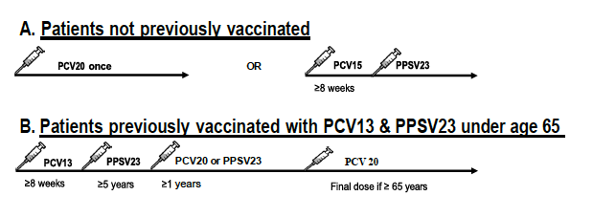
New Pneumococcal vaccine recommendations for Patients with IBD immunosuppressed
Crosby S, et al. Inflamm Bowel Disease 2022
Kobayashi R, et al. MMWR 2022;71:109–117.
Notes:
Pneumococcal immunization is always complicated
Populations based study have shown that patients with IBD are at increased risk for pnuemoccal pneumonia.
Two new pneumococcal vaccines are now available to help prevent pneumococcal pneumonia.
They have replaced the previous PCV 13.
There are two options the PCV 20 or PCV 15.
In those who have not been previously vaccinated there are two options.
We don’t have data that one options has better immunogenicity or efficacy, but the PCV 20 is a better option given the one and done. Option.

Slide 7
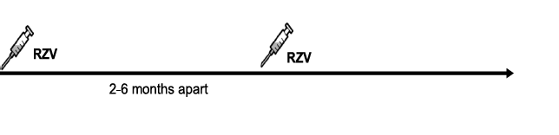
Prevention of HZ: Recombinant HZ vaccine
Recombinant herpes zoster vaccine (RZV) is a two-dose series
All adults 50+
Adults 19 > years who are or will be immunodeficient or immunosuppressed because of disease or therapy.
  Vaccine can be provided 1 month apart
Where to vaccinate?
  Local Pharmacy
  GI clinic – prior auth coverage
  Appeal Denials
Anderson TC, et al. MMWR Morb Mortal Wkly Rep 2022;71:80–84.
Notes:
It has been known for a while that patients with IBD are at increased risk for Herpes zoster.
Preventing was not possible in most patients because the only vaccine that was available was the live attenuated vaccine that is no longer available in the US.
The recombinant herpes zoster vaccine has replaced that vaccine and is available for all paatients 50 and up.
Its available for all adults 19 and up who or will be immunodeficient and increased risk for HZ.
The RZV vaccine is provided as a two dose series 2-6 months apart and can provided 1 month apart in immunosuppressed.
The vaccine has been found to be safe in patients with IBD and able to produce robust response in other immunosuppressed populations.
We need data on how well it work in immunosuppressed populations.
A big issue is where to have your patients vaccinated,
You can use a local pharmacy, clinic, prior authorization the vaccine and etc.

Slide 8
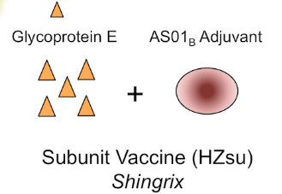
Cost-Effectiveness of an Adjuvanted Recombinant Zoster Vaccine in Adults with Inflammatory Bowel Disease
In our model, vaccination with Recombinant Zoster Vaccine (RZV) was cost effective for all adult patients with Inflammatory Bowel Disease.
In our model vaccination with RZV improved quality adjust life years for all patients. Vaccination also reduced morbidity from herpes zoster by preventing these events and complications due to herpes zoster.
Caldera, et al. Aliment. Pharmacol. Ther 2023 Jun57(11)1326-1334.
Notes:
We constructed a Markov model to evaluate the cost effectiveness of providing an RZV vaccine series in patients with IBD.
W

Slide 9
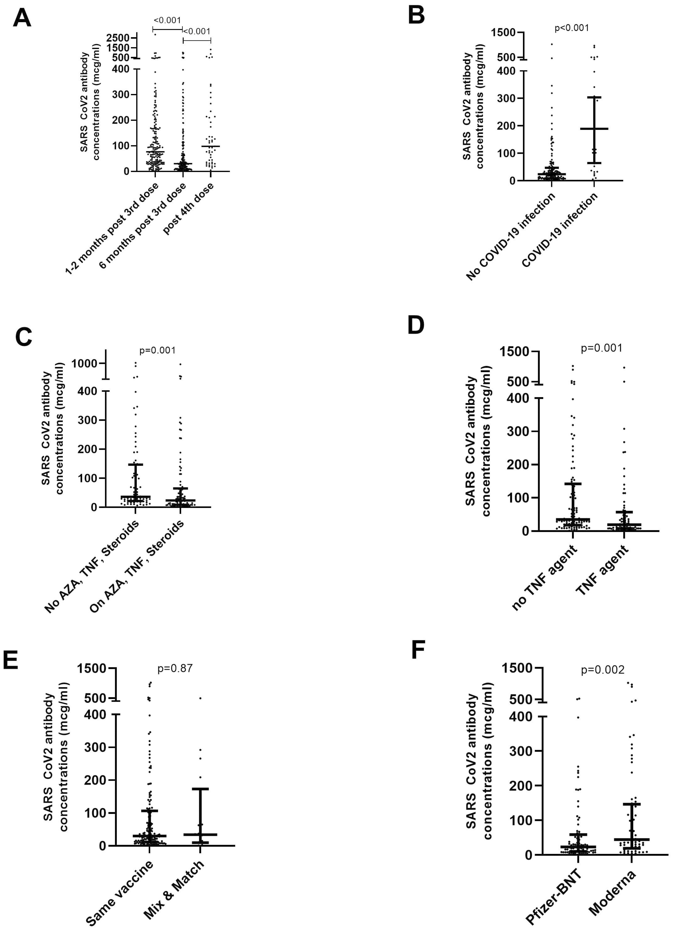
Summary of studies evaluating humoral immune response after COVID-19 vaccination in patients with IBD
Humoral Immunogenicity
Patients with IBD have lower antibodies than healthy controls
Those on anti-TNF therapy may have lower antibodies
Vedolizumab, ustekinumab not associated with lower antibodies
Robust antibody responses are seen after three doses of COVID-19 vaccines.
Sustained antibody responses six months after third dose, COVID infection produces a robust response
Caldera F, et al. ACG. 2022;117(1):176-179.
Lin S, et al. Nat Commun. 2022;13(1):1379
Long MD, et al. Clinical gastroenterology and Hepatology (2022)
Schell TL, et al. Inflamm Bowel Dis. 2022
Li D, et al. Inflamm Bowel Dis. 2022

Slide 10
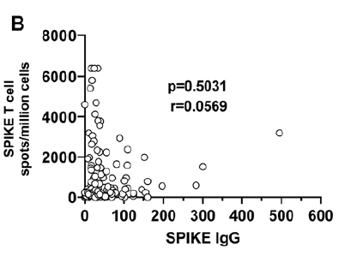
Summary of studies evaluating cell-mediated immune responses after COVID-19 vaccination in patients with IBD
Cell-Mediated Immunogenicity
Caldera F, et al. ACG. 2022;117(1):176-179.
Lin S, et al. Nat Commun. 2022;13(1):1379
Long MD, et al. Clinical gastroenterology and Hepatology (2022)
Schell TL, et al. Inflamm Bowel Dis. 2022
Li D, et al. Inflamm Bowel Dis. 2022

Slide 11
Alternative Immunization Schedule for patients with IBD
Vaccine | Recommendations
COVID-19 vaccine | Follow Recommendations for General population
Influenza vaccine | All patients Older adults >65 years of age High Dose, Recombinant or Adjuvant Vaccine Those on Anti-TNF monotherapy High dose influenza vaccine
PCV 15, PCV 20 or PPSV 23 | All patients with IBD 19 years of age and older on immunosuppressive therapy
Recombinant Herpes Zoster Vaccine | All patients with IBD 19 years of age and older
Hepatitis B vaccine | All adults patients with IBD not previously immunized
HPV vaccine series | All adults up to age 26 27-45* shared clinical decision
Caldera et al, ACG115(9):1356-1361, September 2020.

Slide 12
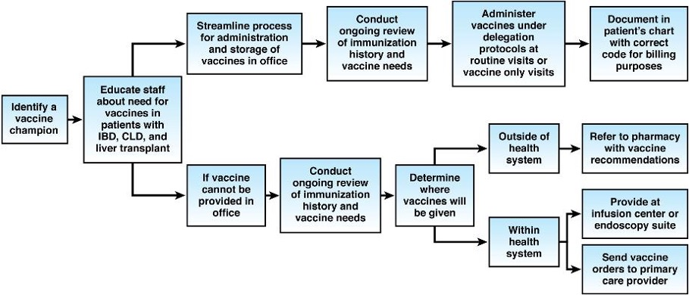

How to Implement a Successful Vaccination Program
Bhat S, et al . 2023 Gastroenterology June 164(7) 1047-1051.
Notes:
We also wrote a review of how to implement a successful vaccination program in gastroenterology practice
This could easily be implement in any medical specialty
The first thing you need to identify a vaccine champion that will take responsibility for learning knowledge about vaccines
And able to educate their colleagues, and staff about the safety of these vaccines in the special population.
One of the first steps is to determine if vaccine can be provide in clinic.
At the digestive health center we have influenza, pneumococcal, tetanus vaccines in clinic
We have delegation protocols at UW health that allow MA to provide vaccines based on provider recommendation.
If you are able to provide vaccine in clinic or are using telehealth you really should consider sending direct order to PCP, refer patient to a pharmacy

Slide 13
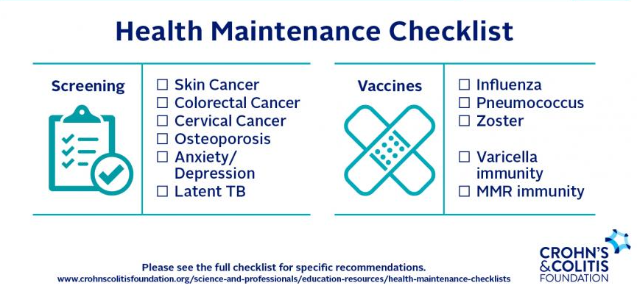
What else?
Human Papilloma Virus
Hepatitis B Vaccine
Tetanus, Diphtheria and Pertussis
No live Vaccines

Slide 14
Thank you! Questions?
fcaldera@medicine.wisc.edu
dr_fcalderaibd

