Slide 1
Management of Postoperative Crohn’s Disease
Miguel Regueiro, MD
Chair, Digestive Diseases and Surgery Institute
Professor of Medicine, Lerner College of Medicine, Case Western University
Cleveland Clinic
Oriana M. Damas, MD, MSCTI
Associate Professor of Medicine
Director of Translational Studies for the Crohn's and Colitis Center
Division of Digestive Health and Liver Diseases
University of Miami Miller School of Medicine

Slide 2
Learning Objectives
To understand the natural course of postoperative Crohn’s disease
To describe the risk factors for recurrence after surgery
To review the medical options for prevention and treatment

Slide 3
Talk Outline
Surgery
Monitoring
Recurrence
Risk Factors
Prophylaxis
To review current risk stratification for postoperative Crohn’s recurrence after resection.
To understand available data for newer biologic mechanisms as medical prophylaxis for recurrence.
To describe management algorithms for preventing, detecting, and managing postoperative Crohn’s recurrence.

Slide 4
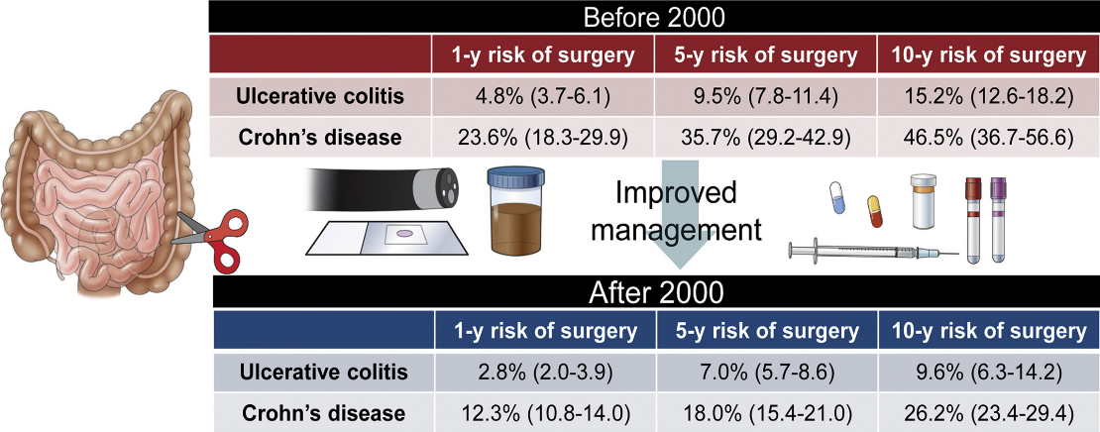
Surgery Remains Common in Crohn’s
Common indications: disease complications (stricture, abscess, fistula), refractory inflammation, neoplasia
Tsai L, et al. Clin Gastroenterol Hepatol. 2021 Oct;19(10):2031-2045

Slide 5
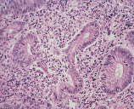
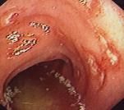

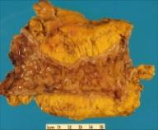
What We Know – Natural History
Recurrence is clinically silent initially
Histologic
Endoscopic
Radiologic
Clinical
Surgical
Within
1 week
70-90%
by 1 yr
Tissue damage
30% 3 yr
60% 5 yr
50% by 5 yrs
Surgery
D’Haens GR, et al. Gastroenterology. 1998;114(2):262-267. Olaison G, et al. Gut. 1992;33(3):331-335. Rutgeerts P, et al. Gastroenterology. 1990;99(4):956-963. Sachar DB. Med Clin North Am. 1990;74(1):183-188.
Slide courtesy of Miguel Regueiro

Slide 6
Surgery
Recurrence
Risk Factors

Slide 7
Many POR Risk Factors Explored
Factor Category | Risk Factor Associated
Patient | Age | Family history of IBD
 | Sex | Active smoking
 | Race
Disease | Age of disease onset | Anatomic extent involved/length of resection
 | Time to surgery from diagnosis | Clinical activity at surgery
 | Prior surgical resection | Prior medical therapies
 | Disease location | Disease behavior
Genetics | NOD2/CARD15
 | CARD8
Serology | Anti-Saccharomyces cerevisiae (ASCA) | Anti-flagellin (cBIR)
 | Outer membrane protein C (Omp-C) | Anti-glycan
 | Pseudomonas I2
Microbiome | Proteus | Fusobacteria
 | Lachnospiraceae | Faecalibacterium
Operative Intervention | Surgical approach (laparoscopic vs laparotomy) | Anastomotic orientation, technique
 | Blood transfusion requirement | Mesenteric excision extent
 | Excision margin length | Strictureplasty
 | Perioperative complication
Histology | Margin involvement | Myenteric and submucosal plexitis
 | Granulomas | Transmural inflammation
Other “-omics” | Tissue transcriptomics
 | Blood transcriptomics
 | Urinary metabolomics

Slide 8
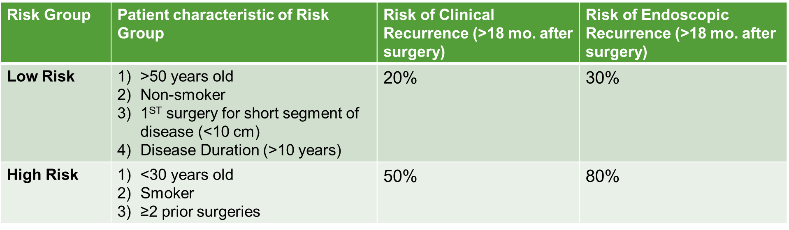
AGA “Illustrative” Risk Factors for POR
Endoscopic Monitoring
Medical Prophylaxis
Regueiro M, et al. Gastroenterology. 2017;152(1):277-295.
Nguyen GC, et al. Gastroenterology. 2017;152(1):271-5.

Slide 9
What can we tell patients about diet and lifestyle for prevention of post operative recurrence?

Slide 10
Adherence to an elemental diet for prevention of POR of Crohn’s disease
38 patients total examined
Ohara, et al. Sug today. 2017
Notes:
Discuss smoking, other potential unexplored factors.
Impact of diet on non-op CD.

Slide 11
Should we monitor and wait for postoperative recurrence to start meds or start a medication within one month of surgery?

Slide 12
Crohn’s disease management after intestinal resection: a randomized postoperative Crohn’s endoscopic recurrence (POCER) trial
Primary Outcome: 18 mos Endoscopic Recurrence
Randomization: Group 1 had a 6 month colonoscopy (if CD then escalate rx) vs Group 2 no 6 month colonoscopy
All patients received postop metronidazole x 3m
Low Risk for recurrence: No additional Medication
High Risk: Thiopurine or Adalimumab if intolerant or previously failed thiopurine
De Cruz P, et al. Lancet. 2015;385(9976):1406-1417.

Slide 13
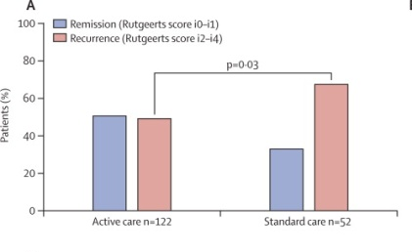
49% vs 67% Endoscopic Recurrence at 18 Months in Active vs Standard Care Pts
67%
49%
18 months
De Cruz P, et al. Lancet. 2015;385(9976):1406-1417.

Slide 14
By Scoping at 6 months and Intensifying Rx:
18% Lower Rate of Endoscopic Recurrence
67%
49%
18 months
De Cruz P, et al. Lancet. 2015;385(9976):1406-1417.

Slide 15
SOPRANO-CD: Endoscopy-driven vs. Biologic Prophylaxis
Multicenter, randomized, parallel group pragmatic non-inferiority trial
  Prophylaxis: start postop W2, all approved biologics
  Endoscopy-driven: colonoscopy W30, start biologics after if POR
Primary outcomes: endo POR (>=i2b) W86, need for treatment adaptation
Secondary outcomes: clinical, biological, surgical POR, SAEs, costs, work productivity, QOL
Status: enrolling
Estimated completion: 2027
ClinicalTrials.gov Identifier: NCT5169593

Slide 16
Surgery
Recurrence
Prophylaxis

Slide 17
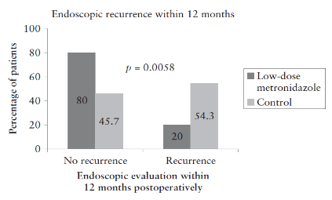
What We Know – Medical Prophylaxis
Metronidazole
Therapy/Intervention | POR Prevention
Curcumin | -
Vitamin D | -
Enteral Nutrition | +
Probiotics | -
Nitroimidazole/Antibiotics | +
Anti-AIEC | ?
Mesalamine | -
Budesonide | -
Thiopurines | +
Anti-TNF | +++
Non-anti-TNF | ?
Infliximab
Shah R, Click B. Therap Adv Gastroenterol. 2021 Feb 15;14:1756284821993581
Glick et al Journal of Crohn’s and Colitis 2019
Regueiro M, et al. Gastroenterology. 2016;150(7):1568-1578.

Slide 18
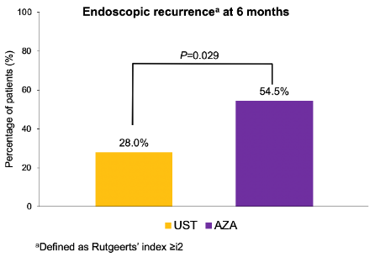
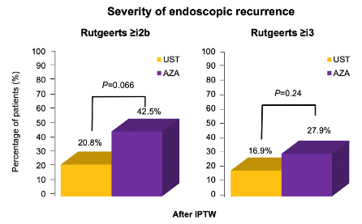
Non-anti-TNF Biologics for Prophylaxis
Propensity matched
P = 0.22
P = 0.32
P = 0.03
6-12 mo Remission
Yamada A, et al. Inflamm Bowel Dis. 2018 Feb;24(3):502–9.
Buisson A, et al. United European Gastroenterol J. 2021 Jun;9(5):552-560.

Slide 19
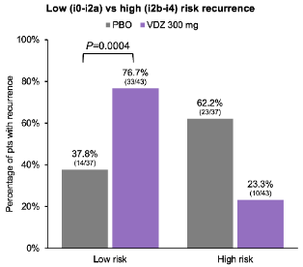
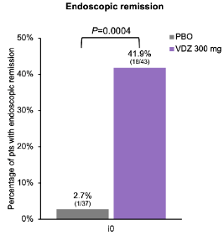
REPREVIO: Vedolizumab
(6 month ileocolonoscopy)
D’Haens et al. ECCO 2023
Prospective RCT investigating the preventive effect of VDZ 300 mg q8w on recurrence of CD following ICR with anastomosis
  - Pts had ≥1 risk factor for recurrence: active smoking (>10 cigarettes/d), ≥1 prior resection, surgery for perforating complication (abscess, fistula); prior anti-TNF
  - VDZ or PBO initiated within 4 wk after surgery; ileocolonoscopy performed 6 mo post-surgery; central scoring using modified Rutgeerts’ score

Slide 20
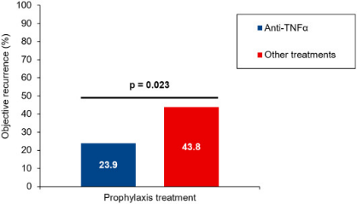
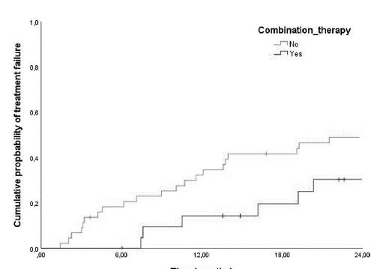
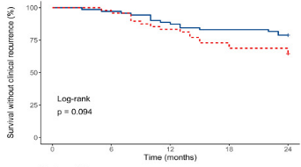
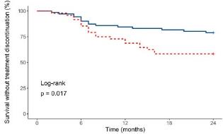
Recycling aTNFs Postop is effective
Mono
Mono
Treatment Failure
aTNF
aTNF
Clinical recurrence
Non-aTNF
Rx Persistence
Non-aTNF
Combo
Combo
No difference by nature of preop aTNF failure, indication for ICR, changing to different aTNF, or # of preop aTNFs
No difference in prior aTNF reason for failure
PNR to preop aTNF: higher risk of POR (HR 3.7 [1.32-10.35])
Le Cosquer G, et al. Dig Liver Dis. 2022 Sep 30:S1590-8658(22)00696-X.
Ten Bokkel Huinink S, et al. Eur J Gastroenterol Hepatol. 2023 Jan 1;35(1):45-51.
Notes:
Going back to aTNF in preop aTNF exposed pts is viable option. May be associated with improved recurrence rates compared to non-aTNFs, but reason for aTNF “failure” may be important
If going back to aTNF, some data to suggest that combination therapy with immunomodulator may be more protective against recurrence compared to monotherapy

Slide 21
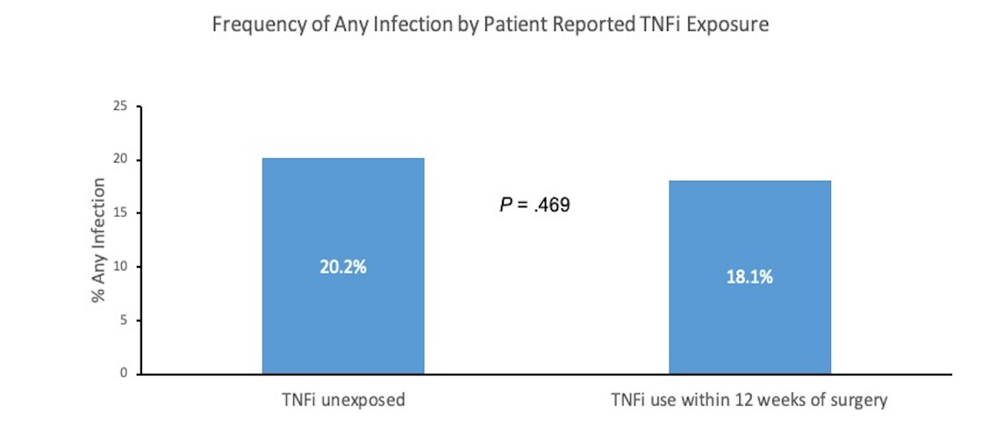
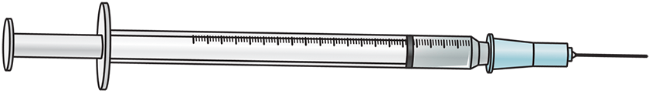




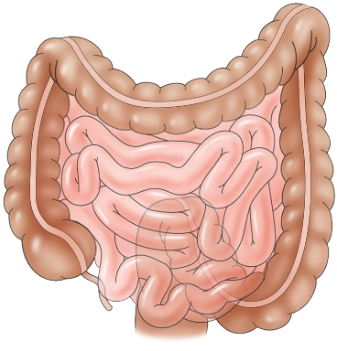


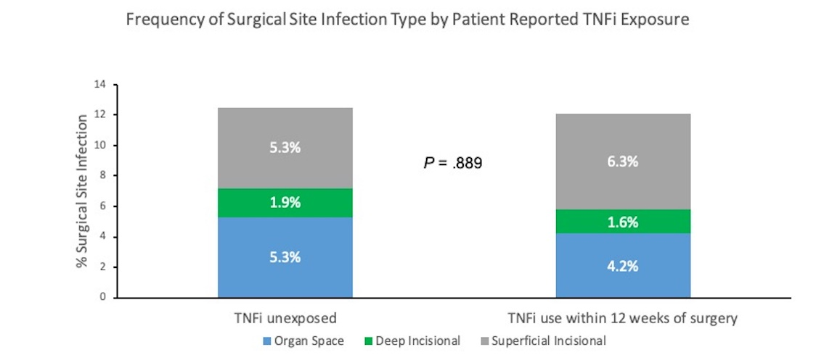

Prospective Cohort Study Investigating Safety of Preoperative TNFi Exposure in IBD Patients Undergoing Intra-abdominal Surgery (PUCCINI)
Not associated with Any Infection or SSI
N = 382
Corticosteroids
Past
Diabetes
N = 947
+ association with Any Infection & SSI
N = 565
Cohen BL, et al. Gastroenterology 2022; 163(1): 204-221

Slide 22
Which is more effective at preventing Postop Crohn’s disease recurrence?
TNFi or Vedolizumab?

Slide 23
We don’t know, there are no head to head studies……….
……….and, now, I’m going to do something “bad” and compare across studies!

Slide 24
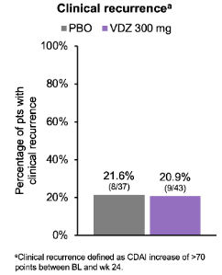
Clinical Recurrence is low with IFX and VEDO, and no different than Placebo
Regueiro M, et al. Gastroenterology. 2016;150(7):1568-1578.
D’Haens et al. ECCO 2023

Slide 25
Endoscopic recurrence
IFX = 22.4% and VEDO = 23.3%
D’Haens et al. ECCO 2023
Note: different study design and endpoints

Slide 26
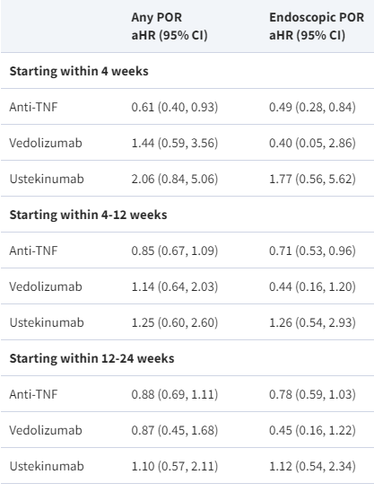
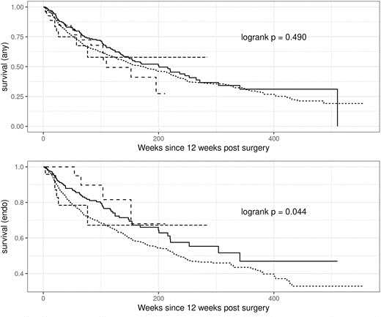
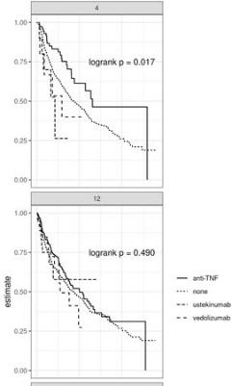
It may be more about time-to-initiation (within 4 weeks) rather than which biologic
Biologic initiation
4 wks
Composite
VDZ
12 wks
UST
Endoscopic
Anti-TNF
None
Axelrad JE, et al. Inflamm Bowel Dis. 2022 Jul 29: PMID: 35905032.

Slide 27
My Approach: High vs Low Risk
Low
High
No Meds
*Mono with TDM or combo if antibodies
Vedo if prior TNFi
ILs? Antibiotics?
*Anti-TNF monotx
Calpro 3m + IUS? Colonoscopy <12m
Calpro 3m + IUS? Colonoscopy <12m
No Recurrence
Recurrence
No Recurrence
Recurrence
Colonoscopy every 1-3 yrs
Immunomodulator or anti-TNF
Colonoscopy every 1-3 yrs
↑ anti-TNF or Δ biologics
1st surgery, NOT for penetrating ds (fistula above stricture?)
Penetrating ds (no stricture), > 2 surgeries

Slide 28
Take-Home Points – Postop Crohn’s
Recurrence of postoperative Crohn’s disease is common
Penetrating disease, young age, and recurrent surgery are predictors of recurrence – these are the high risk patients
Smoking is the only modifiable environmental factor
TNFi and Vedo may prevent recurrence in high-risk patients (if previous TNFi failure, then I suggest Vedo)
Small bowel US (CTE/MRE) and fecal calprotectin may be noninvasive ways to monitor postoperative recurrence
A postop colonoscopy within 12 months has become standard of care, but remaining questions:
  Who to start postop meds immediately (and which one)?
  Who to wait on postop meds (not too long or “damage too far gone”)?

