Slide 1
Positioning Highly Effective Therapy in Ulcerative Colitis
Gary R Lichtenstein, MD, FACP, FACG, AGAF
Professor of Medicine
University of Pennsylvania School of Medicine
Vice Chief, Gastroenterology
Development and Philanthropy
University of Pennsylvania Health System
Philadelphia, Pennsylvania
Lisa B Malter, MD, FACG, AGAF
Professor of Medicine
Division of Gastroenterology
Director of Education, IBD Center
Director of IBD Program, Bellevue Hospital
NYU Grossman School of Medicine
New York, New York

Slide 2
Disclosures
Abbvie Consultant, CME
American Gastroenterological Association CME
American Regent
(Creative Educational Concepts) Consultant, Honorarium (CME Program)
Bristol Meyers Squibb Consultant, Research
Eli Lilly Consultant, DSMB (Data Safety Monitoring Board)
Focus Medical Communication CME
(Multiple Sponsors of CME- AbbVie, Janssen, Ferring, Pfizer, Sanofi, Salix, Takeda, Bristol Meyers Squibb, Exact Sciences, Eli Lilly, Seres Pharmaceuticals, Boehringer Ingelheim)
Gastroenterology and Hepatology
(Gastro-Hep Communications) Editor (Honorarium)
IBD Horizons CME - supported by Annenberg Center for Health Sciences at Eisenhower
Janssen Orthobiotech Consultant, Research, Funding to University of PA (IBD Fellow Education)
Kabi Fresenius
(Health and Wellness Partners) Consultant
MedEd Consultants Consultant
Pennsylvania Society of Gastroenterology CME
Pfizer Pharmaceuticals Consultant, Funding to University of PA (IBD Fellow Education)
Physician Education Resource CME
(Multiple supporters: Amgen, Janssen Biotech, Janssen Scientific, Pfizer, Salix)
SLACK, Inc Book Royalty
Springer Science and Business Media Editor (Honorarium)
Takeda Consultant, Research
UCB Consultant, Research
Up To Date- Walters Kluwer Author (Honorarium)

Slide 3
Outline
Common case-based clinical scenarios to consider treatment options for moderate to severe UC:
Bio-naive patients
Patients with concomitant extraintestinal manifestations
Bio-experienced patients
Acute severe UC

Slide 4
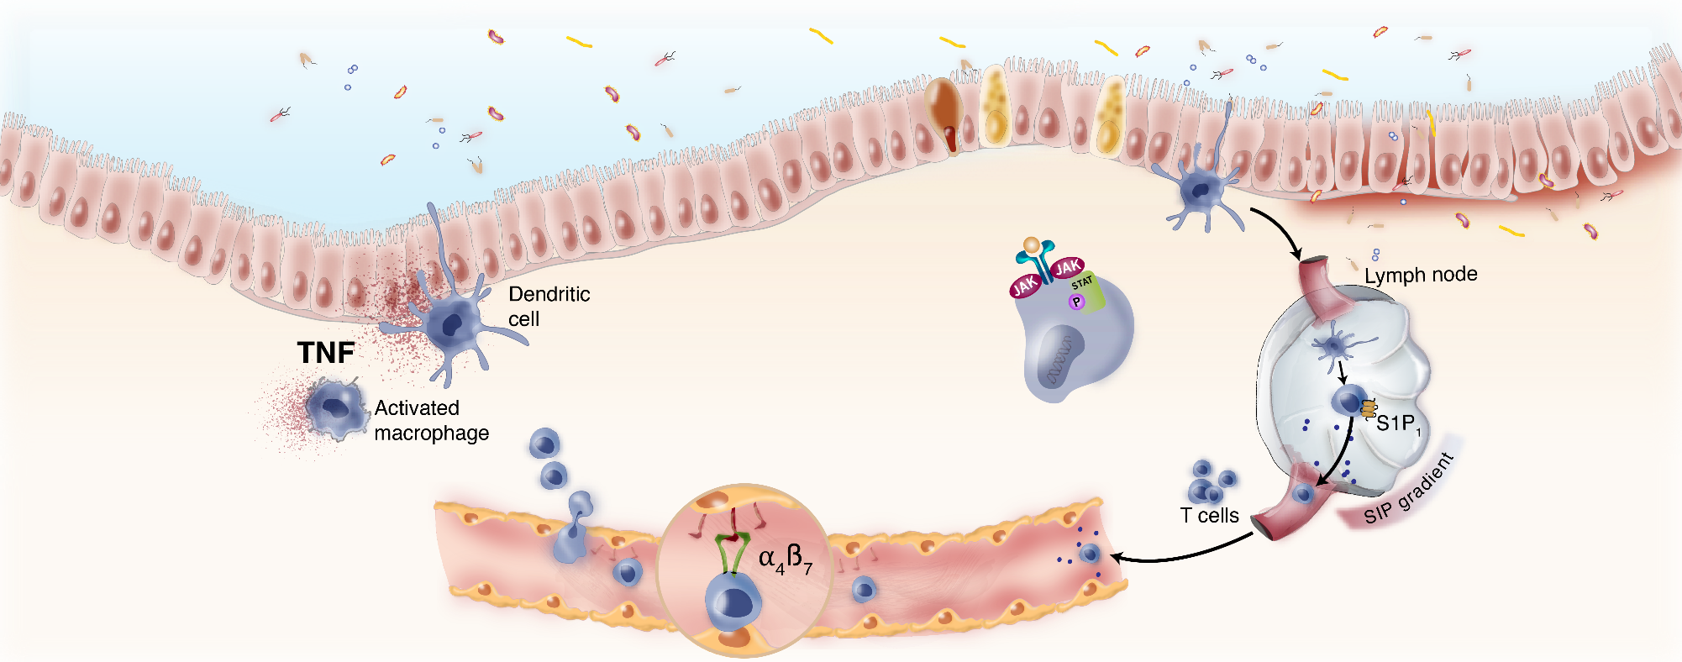
Current and Emerging Therapeutic Strategies for IBD
Anti-IL-12/23 agents
Ustekinumab
Brazikumab*
Risankizumab
Mirikizumab*
Guselkumab*
Anti-TNF agents
JAK inhibitors
Infliximab
Adalimumab
Golimumab
Certolizumab Pegol
Tofacitinib
Upadacitinib
Filgotinib*
Deucravacitinib*
S1P1 inhibitor
Ozanimod
Etrasimod*
Anti-integrins
Vedolizumab
Natalizumab
Notes:
Not copyrighted - https://www.sciencedirect.com/science/article/abs/pii/S0165614716301584

Slide 5
Pieces of the Therapy Choice Puzzle in IBD
DRUG
PATIENT
Efficacy
Individual Characteristics
Indication
Rapidity of onset
Durability
Pharmacokinetics/TDM
Combination vs monotherapy
Age, pregnancy, comorbidities, and preferences
Positioning and sequence
DISEASE
CARACTERISTICS
SAFETY
CD extent
Disease behavior/complication
Disease severity
Early vs late
EIMs
Infection
Cancer
Specific concerns by agent or mechanism
Drug interactions
Prior treatment success or failure

Slide 6
Biologic Naïve Moderate to Severe UC

Slide 7
Case 1: Bio-naïve UC
35 yo M with PMH of Non-Hodgkins lymphoma diagnosed age 9 s/p chemotherapy with CHOP and rituximab in remission. He presented with UC diagnosed 9 months ago when he presented to his primary physician with rectal bleeding, abdominal cramping and diarrhea. He had a colonoscopy with proctosigmoiditis with endoscopic severity of a Mayo 1. The disease extended to 25 cm from the anal verge. Stool studies were negative and he was initiated on oral mesalamine (delayed release) at 4.8 gram a day.
He did well until 6 weeks ago when his symptoms returned associated with an increase in his CRP from 1.0 to 28
Flexible sigmoidoscopy confirmed Mayo 2 colitis
What should the next therapy be?
Notes:
Typical patient you may see in the community or at an IBD center. A young, bionaive patient with moderate UC
But in today's growing armamentarium of therapeutic options, the conversation we have with this patient looks different than it did not 5 years ago
- Consder Vedolizumab or USTekinumab

Slide 8
Which Therapy First, Second, Third… for UC?
Only one head-to-head published UC study We rely on network meta-analysis; not perfect,
but that’s the best we have at this time

Slide 9
VARSITY: Efficacy of Vedolizumab vs Adalimumab at Wk 52 in UC
Double-blind, randomized phase IIIb study in N=790 adults with moderate to severe UC (up to 25% with prior non-adalimumab TNFi)
Designed as a superiority trial
At Week 52, vedolizumab was superior to adalimumab for clinical remission and endoscopic improvement, but not corticosteroid-free clinical remission
Endoscopic Improvement
Primary Endpoint: Clinical Remission
P<0.001
Corticosteroid-Free Clinical Remission
P=0.006
Primary Endpoint: Clinical Remission
Endoscopic Improvement
Corticosteroid-Free Clinical Remission
39.7
(95% Cl, -18.9 to 0.4)
31.3
27.7
22.5
21.8
Patients (%)
12.6
Patients (%)
24.3
(N=386)
(N=383)
(N=386)
(N=383)
(N=119)
(N=111)
Adalimumab
Vedolizumab
Adalimumab
Vedolizumab
Adalimumab
Vedolizumab
Sands. BE, et al. NEJM. 2019;381:1215.
Notes:
Sands BE, Peyrin-Biroulet L, Loftus EV, et al. Vedolizumab versus Adalimumab for Moderate-to-Severe Ulcerative Colitis. N Engl J Med. 2019;381:1215-1226.

Slide 10
VARSITY: Efficacy of Vedolizumab vs Adalimumab by Previous TNFi Exposure
Limitations to VARSITY
No dose escalation
No drug levels
If on steroids or IMMs, no difference between groups
No benefit in prior TNF exposure group
Primary Endpoint: Clinical Remission
Endoscopic Improvement
Corticosteroid-Free Clinical Remission
43.1
Patients (%)
34.2
29.5
26.6
24.3
20.3
21.0
21.7
22.2
16.0
14.9
4.2
(N=305)
(N=304)
(N=81)
(N=79)
(N=305)
(N=304)
(N=81)
(N=79)
(N=92)
(N=87)
(N=27)
(N=24)
No Previous TNF
Inhibitor Therapy
Previous TNF
Inhibitor Therapy
No Previous TNF
Inhibitor Therapy
Previous TNF
Inhibitor Therapy
No Previous TNF
Inhibitor Therapy
Previous TNF
Inhibitor Therapy
Adalimumab
Vedolizumab
Sands. BE, et al. NEJM. 2019;381:1215.
Notes:
Sands BE, Peyrin-Biroulet L, Loftus EV, et al. Vedolizumab versus Adalimumab for Moderate-to-Severe Ulcerative Colitis. N Engl J Med. 2019;381:1215-1226.

Slide 11
Using Network Meta-Analyses When We Don’t Have Head-to-Head Studies

Slide 12
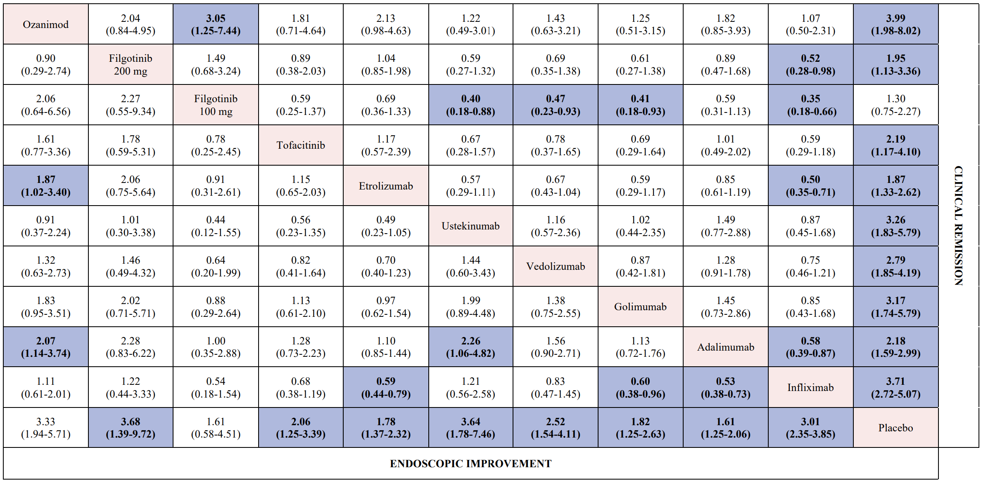
Network Meta-Analysis: Indirect comparison for induction of clinical remission and endoscopic improvement in the biologic-naïve moderate to severe UC population
The violet boxes represent statistically significant comparisons, and the white boxes represent non-statistically significant comparisons.
Lasa JS et al. Lancet Gastroenterol Hepatol 2022; 7: 161–70
Notes:
The induction of clinical remission and endoscopic improvement was evaluated in biologic-naive and biologic-exposed populations in prespecified analyses.
Data for upadacitinib according to previous biologic exposure were not available and so not included in this analysis.
For the induction of clinical remission in biologic-naive patients, all interventions, except for filgotinib 100 mg, were superior to placebo in our pairwise, direct meta-analysis (data not shown); heterogeneity was substantial (I²=57%).
When comparing active treatments in our network meta-analysis in the biologic-naive population, adalimumab (moderate confidence), etrolizumab (moderate confidence), filgotinib 100 mg (moderate confidence), and filgotinib 200 mg (moderate confidence) were significantly inferior to infliximab; additionally, ustekinumab, vedolizumab, golimumab, and ozanimod were significantly superior to filgotinib 100 mg (moderate confidence; appendix p 25).
Infliximab (SUCRA 0·853) and ozanimod (0·847) ranked the highest for the induction of clinical remission among biologic-naive patients (appendix p 26).
Clinical Remission- defined as Mayo Clinic Score ≤2 with no individual subscore >1
Endoscopic Improvement - defined as endoscopy subscore of Mayo Clinic Score of 0 or 1

Slide 13
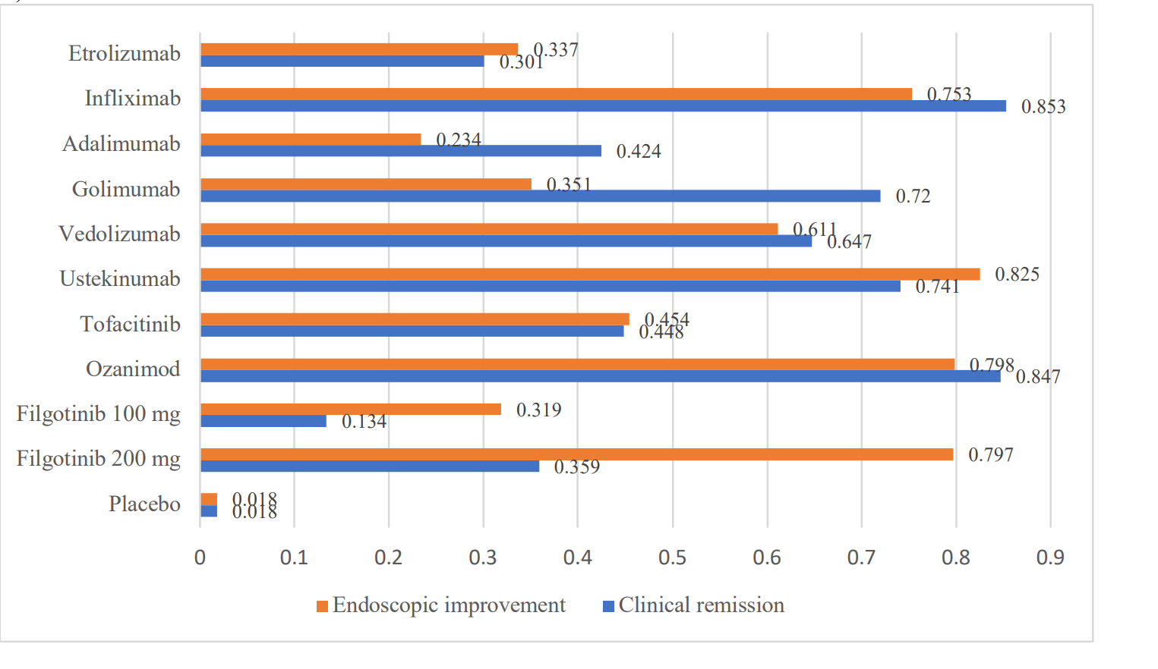
Network Meta-Analysis: Sequencing of Induction Therapy for Patients with Moderately-to-Severely Active UC
SUCRA Ranking for moderate to severely active ulcerative colitis patients
29 trials,10,061 patients with UC
Endpoints: Wk 6-14
IFX, OZA and UPA - 1st for efficacy overall
Relative efficacy of different interventions for induction of clinical remission and endoscopic improvement in biologic-naïve patients with moderate to severely active ulcerative colitis
Lasa JS et al. Lancet Gastroenterol Hepatol 2022; 7: 161–70
Notes:
SUCRA - is a metric used to evaluate which treatment in a network is likely to be the most efficacious in the context of network meta-analyses. It is a summary of the rank distribution, which can be interpreted as the estimated proportion of treatments worse than the treatment of interest. SUCRA values range from 0 to 100%, with higher values indicating a higher likelihood that a therapy is in the top rank or one of the top ranks
Clinical Remission- defined as Mayo Clinic Score ≤2 with no individual subscore >1
Endoscopic Improvement - defined as endoscopy subscore of Mayo Clinic Score of 0 or 1

Slide 14
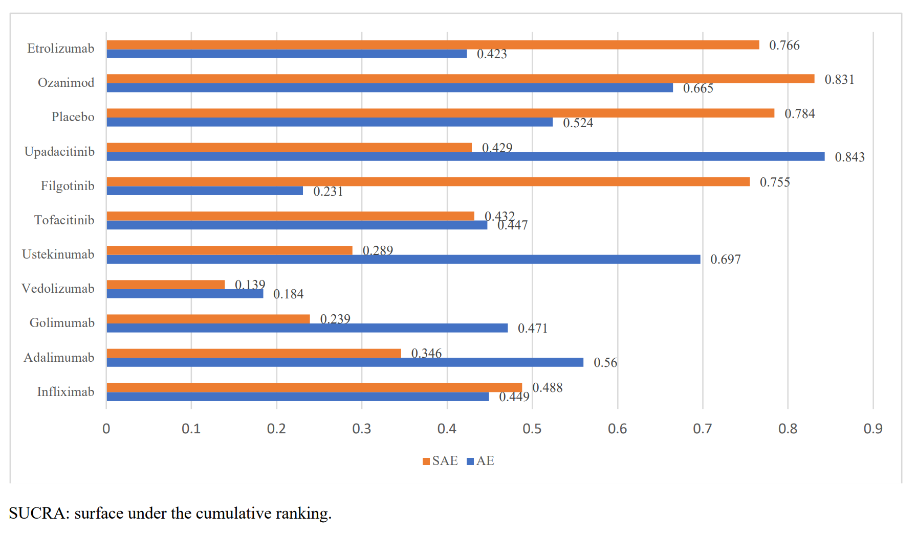
Network Meta-Analysis: SUCRA values for adverse events and serious adverse events (overall population)
SUCRA Ranking for moderate to severely active ulcerative colitis patients
No drug more likely than placebo to lead to SAE
RR of SAE significantly less with Vedo, Golimumab and UST- than placebo
Vedolizumab was the best performing agent for safety outcomes.
UPA 45 mg most likely to lead to AE and VEDO was the least likely
UPA 45 mg ranked last for infections (significant compared to placebo)
Lasa JS et al. Lancet Gastroenterol Hepatol 2022; 7: 161–70
Notes:
SUCRA - is a metric used to evaluate which treatment in a network is likely to be the most efficacious in the context of network meta-analyses¹. It is a summary of the rank distribution, which can be interpreted as the estimated proportion of treatments worse than the treatment of interest. SUCRA values range from 0 to 100%, with higher values indicating a higher likelihood that a therapy is in the top rank or one of the top ranks
Clinical Remission- defined as Mayo Clinic Score ≤2 with no individual subscore >1
Endoscopic Improvement - defined as endoscopy subscore of Mayo Clinic Score of 0 or 1

Slide 15
Specific Scenarios for Choice of First IBD Therapy
Modifier | First drug consideration | Reason
Psoriasis | Ustekinumab Risankizumab Anti-TNF | On label
>60 years Comorbid cancer Comorbid infection | Vedolizumab-1st Ustekinumab-1st Ozanimod -2nd if no CV disease | Older patients have higher risk of infections
Synovitis Arthritis | Anti-TNF, Upadacitinib, Tofacitinib | On label
Low albumin, High BMI | Tofacitinib, Upadacitinib? Cyclosporine (not discussed) Tacrolimus (Not discussed) | Non-protein-based therapies (not a biologic)
Need for speed (e.g. Acute Severe UC) | Infliximab Tofacitinib Upadacitinib | Rapidity of onset
Preconception Pregnancy | Any Mab is ok Anti-TNF, Vedolizumab, Ustekinumab Risankizumab | Established safety- treat through pregnancy Stop MTX or AZA/6-MP >3 months and Stop OZA, TOFA, or UPA >1 month -- prior to conception
Combination therapy Not needed | Vedolizumab, Risankizumab Ustekinumab Upadacitinib Tofacitinib | No benefit for combination therapy over monotherapy

Slide 16
Extraintestinal Manifestations Management

Slide 17
Case 2: Extraintestinal Manifestations
32 yo M with PMH of Psoriasis and psoriatic arthritis diagnosed age 29 who was treated with NSAID’s for the arthralgias and topical therapy with Calcipotriene.
Six month ago he began to notice looser stools with rectal bleeding, abdominal cramping and diarrhea.
He had a colonoscopy with proctosigmoiditis with endoscopic severity of a Mayo 2. The disease extended to the mid-transverse colon. Stool studies were negative, and he was initiated on oral Budesonide MMX 9 mg a day x 8 weeks. MRE demonstrated no small bowel disease
He did well until 2 weeks ago when his symptoms returned associated with an increase in his CRP from 1.0 to 31
Flexible sigmoidoscopy confirmed Mayo 2 colitis. Biopsies with immunochemistry demonstrated active changes of ulcerative colitis.
What should the next therapy be?

Slide 18
Need to Consider Diverse Manifestations of IBD When Choosing Therapy
Rogler, G et al. Gastroenterology. 2021;161(4):1118-1132.
Notes:
Inflammatory pathology in patient with IBD outside the gut
Occur before, during or after dx of IBD
Direct or indirect sequela of intestinal inflammation
Between 25-40 % of IBD patients experience EIMs
Up to 26 % of patients will experience an EIM before onset of intestinal manifestation.
1 EIM → increased risk for developing others. 20% IBD pt’s report 2 EIMs. 10 % report 3 or more different EIMs.
In general- colonic disease → more likely to have EIM.

Slide 19
Prevalence of EIMs in IBD
Organ System | Manifestations | Prevalence
Gastrointestinal | PSC Autoimmune pancreatitis Autoimmune hepatitis | UC: up to 5 %; CD rare Rare Rare (<1%)
Mucocutaneous | Erythema Nodosum Pyoderma Gangrenosum Oral aphthous ulcers Sweet syndrome Orofacial granulomatosis | 5%-15% in CD; 2%-10% in UC 0.4%-2.6% in IBD 5%-50% in CD Rare Rare
Musculoskeletal | IBD-related arthritis Peripheral arthritis Axial arthritis Enthesitis | CD: 10%-20%; UC 4%-14% Up to 50% in CD (asymptomatic)
Ocular | Episcleritis and Scleritis Anterior uveitis | Scleritis: up to 1% CD: 5%-12%; UC 3.5%-4.1%
Pulmonary | Pneumonitis | Rare
Vascular | Cardiovascular disease Thromboembolism Portal vein thrombosis | NA 3- to 4- fold increase Rare
Rogler, G et al. Gastroenterology. 2021;161(4):1118-1132.
Gastroenterology 2021 1611118-1132DOI: (10.1053/j.gastro.2021.07.042)
Notes:
Slightly more common in CD vs UC.
Enthesitis – inflammation of the insertion of tendons, ligaments, and joint capsule into the bone.
For the sake of time, during this presentation we will be focusing on the most common EIMs in IBD

Slide 20
EIM + IBD Activity
EIM | Parallels Disease Activity | Independent of Disease Activity | Varies
Peripheral arthritis Large Peripheral Small Peripheral | - X | X
Axial Arthritis |  | X
Erythema Nodosum | X
Pyoderma Gangrenosum |  |  | X
Sweet Syndrome | X
Aphthous stomatitis | X
Episcleritis | X
Uveitis |  | X
PSC |  |  | X
Rogler, G et al. Gastroenterology. 2021;161(4):1118-1132.
Notes:
Peripheral arthritis- large joints of arms and legs such as elbows, wrists, knees and ankles
Peripheral Small- fingers, toes
Axial arthritis – inflammatory arthritis where main symptom is back pain

Slide 21
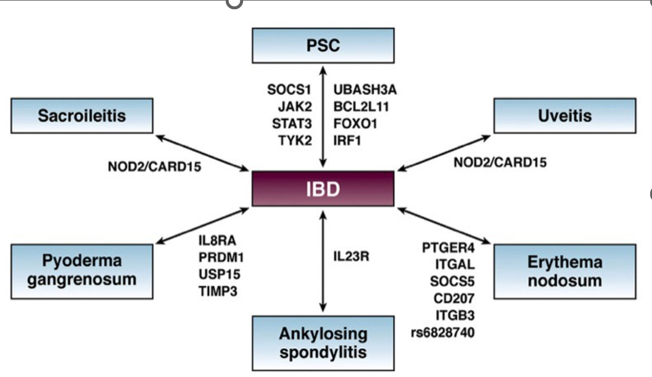
Shared genetic risk factors are present between IBD and the EIMs
Gastroenterology. 2021;161(4):1118-1132.

Slide 22
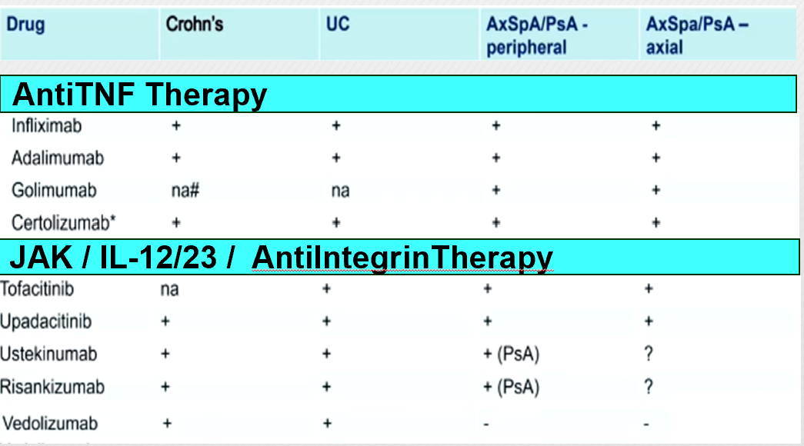
Drugs Used for IBD and Spondyloarthropathies
na- not formally tested or approved
Notes:
Consider a biologic, anti-TNFs have the most data. Both infliximab and adalimumab have proven effective in the management of IBD arthropathy, including axial disease.
Sulfasalazine some efficacy at improving peripheral arthritis in SpA, however not in axial arthritis and back pain.
In recent systemic review, Ustekinumab showed some effectiveness for IBD-associated peripheral arthritis (as well as skin EIMs), but not axSpA.
JAK inhibitors are effective in axial and peripheral arthropathy

Slide 23
Positioning Highly Effective Therapy in Ulcerative Colitis
Gary R Lichtenstein, MD, FACP, FACG, AGAF
Professor of Medicine
University of Pennsylvania School of Medicine
Vice Chief, Gastroenterology
Development and Philanthropy
University of Pennsylvania Health System
Philadelphia, Pennsylvania
Lisa B Malter, MD, FACG, AGAF
Professor of Medicine
Division of Gastroenterology
Director of Education, IBD Center
Director of IBD Program, Bellevue Hospital
NYU Grossman School of Medicine
New York, New York

Slide 24
Disclosures
Ad boards: Abbvie, BMS, Celltrion, Merck, Pfizer and Takeda
Consulting: Abbvie
Educational Grants: Abbvie, Janssen, Pfizer and Takeda

Slide 25
Case 3: Bio-experienced UC
28 yo F with pmhx of UC diagnosed 9 months ago when she presented to the ED with rectal bleeding, abd pain and diarrhea and was initiated on infliximab in the hospital
She was doing well until 6 weeks ago when her symptoms returned associated with an increase in his CRP from 1.5 to 35
Stool studies with no evidence of infection
Flexible sigmoidoscopy confirmed Mayo 2 colitis
Infliximab levels were 20 and there were no antibodies to infliximab present
What should the next therapy be?

Slide 26
FDA Approved Medications for UC
Infliximab
ACT 1& 2 (2005)
Adalimumab
ULTRA 1 & 2 (2012)
Golimumab
PURSUIT SC/M (2013)
Vedolizumab
GEMINI 1 (2014)
Tofacitinib
OCTAVE 1 & 2 (2018)
Ustekinumab
UNIFI (2019)
Upadacitinib
UACHIEVE/UACCOMPLISH (2022)
Ozanimod
TRUENORTH (2022)
Slide courtesy of Megan Murphy, MD

Slide 27
Vedolizumab Has Shown Reduced Efficacy in Anti-TNF-Exposed Patients
GEMINI 1: Efficacy outcomes for vedolizumab induction therapy at week 6
Placebo Vedolizumab
Anti-TNF-naïve
Anti-TNF exposed
𝚫=26.8
𝚫=24.2
𝚫=18.4
𝚫=16.5
𝚫=9.9
Patients, %
Patients, %
𝚫=6.6
n=76
n=130
n=76
n=130
n=76
n=130
n=63
n=82
n=63
n=82
n=63
n=82
Clinical remission | Clinical response | Mucosal healing
Clinical remission | Clinical response | Mucosal healing
Clinical remission: Mayo score ≤2 and no individual subscore >1; clinical response: ≥3-point reduction in Mayo score and ≥30% decrease from
baseline score, with ≥1-point decrease in rectal bleeding subscore or absolute rectal bleeding subscore ≤1; mucosal healing:
Mayo endoscopic subscore ≤1.
Feagan BG, et al. Clin Gastroenterol Hepatol. 2017;15:229-39.
Notes:
At Week 6, there were greater absolute differences in efficacy between vedolizumab and placebo in patients naive to TNF antagonists than patients with failure of TNF antagonists, although the risk ratios (RRs) for efficacy were similar for each group. Week 6 rates of response to vedolizumab and placebo were 53.1% and 26.3%, respectively, among patients naive to TNF antagonists (absolute difference, 26.4%; 95% confidence interval [CI], 12.4-40.4; RR, 2.0; 95% CI, 1.3-3.0); these rates were 39.0% and 20.6%, respectively, in patients with failure of TNF antagonists (absolute difference, 18.1%; 95% CI, 2.8-33.5; RR, 1.9; 95% CI, 1.1-3.2). During maintenance therapy, the absolute differences were similar but the RR for efficacy was higher for patients with failure of TNF antagonists than for patients naive to TNF antagonists, for most outcomes. Week 52 rates of remission with vedolizumab and placebo were 46.9% and 19.0%, respectively, in patients naive to TNF antagonists (absolute difference, 28.0%; 95% CI, 14.9-41.1; RR, 2.5; 95% CI, 1.5-4.0) and 36.1% and 5.3%, respectively, in patients with failure of TNF antagonists (absolute difference, 29.5%; 95% CI, 12.8-46.1; RR, 6.6; 95% CI, 1.7-26.5). No differences in adverse events were observed among groups.

Slide 28
Ozanimod Has Shown Reduced Efficacy in Biologic Failure Patients
​Post hoc analysis of TRUE NORTH evaluating biologic naïve patients in comparison to biologic failure patients was conducted
992 patients of which 616 were biologic-naïve, 162 had exposure to 1 biologic, and 214 were exposed to 2 or more biologics.
Results:
Higher rates of clinical remission in biologic naïve (23% vs 6.6%) compared to 1 biologic failure (17% vs 8%) or 2 or more biologic failures (3.7% vs 2.5%)
For patients with inadequate response to prior anti-TNF agents, vedolizumab, or both at baseline, treatment effects favored ozanimod vs placebo during both induction and maintenance.
Sands BE et al. American Journal of Gastroenterology. 2021;116(1):S313-S314.
Notes:
Clinical remission was achieved in 23% vs 6.6% of patients on ozanimod vs placebo who were biologic naïve, 17.2% vs 8.3% on 1 prior biologic, and 3.7% vs 2.5% on 2 or more biologics. Clinical response was reached in 53% vs 28% of patients on ozanimod vs placebo who were biologic naïve, 50% vs 33% on 1 biologic, and 27% vs 15% on 2 or more biologics. During maintenance, ozanimod-treated patients had greater responses on all endpoints versus placebo, with similar proportions of patients achieving clinical response to ozanimod regardless of prior biologic exposure (61% for biologic naïve, 60% for 1 biologic, and 55% for 2 or more biologics).
At week 52, the proportion of patients on ozanimod with clinical remission was similar in the 1-biologic and 2+-biologic exposure groups (28% and 26%, respectively), and proportions of patients on ozanimod with endoscopic improvement and mucosal healing were similar for the 1-biologic and biologic-naïve groups (47% and 50%, 30%, and 33%, respectively). Among patients with inadequate response to prior anti-TNF agents, vedolizumab, or both at baseline, treatment effects favored ozanimod vs placebo on these endpoints in all three groups during both induction and maintenance.

Slide 29
Ustekinumab Has Not Shown Reduced Efficacy in Anti-TNF-Exposed Patients
UNIFI: Efficacy outcomes for ustekinumab induction therapy at week 8
Placebo Ustekinumab 6 mg/kg
Biologic-naïve
Biologic failure
𝚫=30.9
𝚫=29.9
𝚫=12.1
𝚫=8.5
𝚫=14.3
Patients, %
Patients, %
𝚫=11.5
n=151
n=147
n=151
n=147
n=151
n=147
n=161
n=166
n=161
n=166
n=161
n=166
Clinical remission | Clinical response | Endoscopic improvement
Clinical remission | Clinical response | Endoscopic improvement
Clinical remission: Mayo score ≤2 points, with no individual subscore >1; clinical response: decrease from baseline in Mayo score ≥30% and ≥3 points, with either decrease from baseline rectal bleeding subscore ≥1 or rectal bleeding subscore of 0 or 1; endoscopic improvement: Mayo endoscopic subscore of 0 or 1 (by central review).
Sands BE et al. N Engl J Med. 2019;381:1201-14.

Slide 30
Tofacitinib Has Not Shown Reduced Efficacy in Anti-TNF-Exposed Patients
OCTAVE 1 and 2: Efficacy outcomes for tofacitinib induction therapy at week 8 (ITT population)
Placebo Tofacitinib 10 mg BID
Anti-TNF exposed
Anti-TNF-naïve
𝚫=15.0
𝚫=11.2
𝚫=16.8
Patients, %
Patients, %
𝚫=11.5
n=104
n=417
n=104
n=417
n=130
n=488
n=130
n=488
Clinical remission | Mucosal healing
Clinical remission | Mucosal healing
Clinical remission: total Mayo score ≤2, with no subscore >1 and rectal bleeding subscore of 0;
mucosal healing: Mayo endoscopic subscore ≤1. BID, twice daily; ITT, intention-to-treat.
Sandborn WJ, et al. N Engl J Med. 2017;376:1723-36.

Slide 31
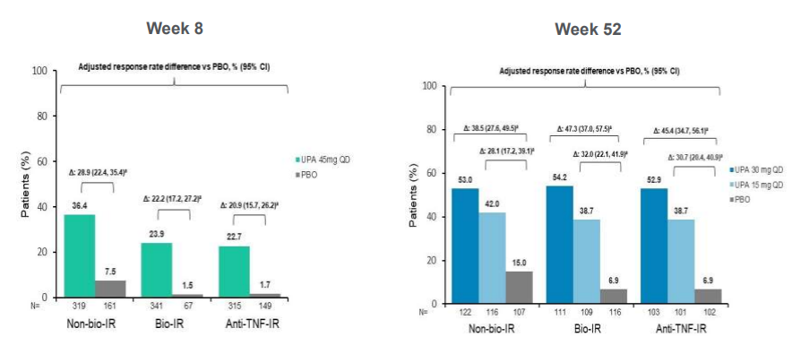
Upadacitinib Has Not Shown Reduced Efficacy in Bio-Exposed Patients for UC
S Vermeire et al. J Crohn's and Colitis, Volume 17, Issue Supplement_1, February 2023, Pages i8–i9.
Notes:
inadequate response (IR; persistently active UC despite ≥1 induction regimen of infliximab, adalimumab, golimumab, vedolizumab or ustekinumab)
loss of response
or intolerance to ≥1 biologic (bio-IR) or anti-TNF agent (anti-TNF-IR) in the Phase 3 trials.
In pts with UC, significantly more pts achieved clinical remission after 8-wk induction and 52-wk maintenance therapy with UPA than PBO in non-bio-IR, bio-IR and anti-TNFIR pts. Generally similar efficacy was observed between the bio-IR and anti-TNF-IR pts, which was consistent with the previously published overall population.^{1,2} These findings suggest that UPA is efficacious for UC regardless of prior therapy with anti-TNF agents or other biologics.

Slide 32
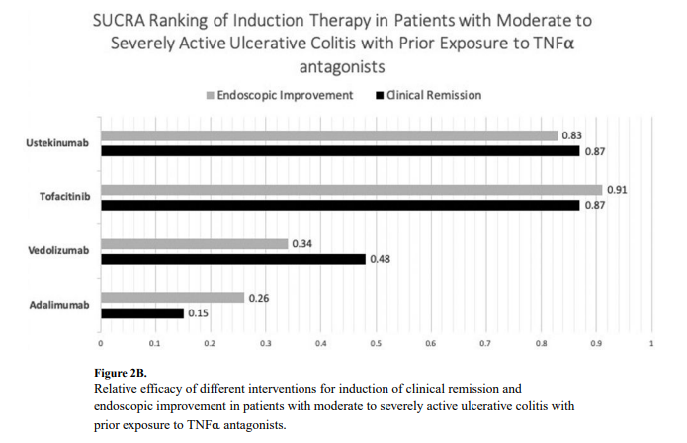
Comparative Efficacy Data: Biologics in the Anti-TNF Exposed Patient
Singh S et al. Clin Gastroenterol Hepatol. 2020;18(10):2179-2191.
Notes:
Here is the same 2020 network meta-analysis but looking at induction therapy in patients with prior TNF exposure, so they are now on their second agent and considered bioexposed.
You can see Ustekinumab and Tofa did great for bio-exposed patients way outperform Vedo and Adalimumab. Something to consider when switching therapy
Again, this is 2020 so no Upa or Ozanimod

Slide 33
Case 4: ASUC
34 yo M with no pmhx presents to the ED with 2 weeks of severe crampy abdominal pain and bloody diarrhea with up to 20 episodes daily
His labs were notable for CRP 97, hgb 10.5, albumin 3 and no evidence of any enteric infection
Abdominal xray was unremarkable
Flexible sigmoidoscopy was consistent with Mayo 3 colitis
He was admitted and initiated on IV steroids but by day 4 he had an incomplete response
What treatment options should be considered now?
Notes:
Typical patient you may see in the community or at an IBD center. A young, bionaive patient with moderate UC
But in today's growing armamentarium of therapeutic options, the conversation we have with this patient looks different than it did not 5 years ago

Slide 34
The Facts…
20-25% of UC patients will require inpatient treatment during their lifetime
30-40% of patients fail to respond to intravenous steroids
Current approved rescue strategies include the use of cyclosporin or infliximab
40%–50% colectomy short-term (<3 months)
70% in the long-term (within 3 years)
Dinesen LC et al. J Crohns Colitis 2010;4:431–437.
Gustavsson A, et al. Am J Gastroenterol 2007;102:2513–2519
Notes:
Typical patient you may see in the community or at an IBD center. A young, bionaive patient with moderate UC
But in today's growing armamentarium of therapeutic options, the conversation we have with this patient looks different than it did not 5 years ago

Slide 35
Infliximab vs. Cyclosporin
Systematic review and network meta-analysis evaluating the two therapies in ASUC
Included 16 studies and ~1500 patients
No difference in treatment response on colectomy rates between the RCTs at both 3 and 12 months post treatment initiation
Observational studies noted:
Higher response to IFX
Lower colectomy rate on IFX at 12 months
Infliximab is the most commonly used salvage therapy related to ease of administration and toxicity profile
Narula N et al. Am J Gastroenterol. 2016 Apr;111(4):477-91.

Slide 36
Infliximab for ASUC
Response rates:
Immediate: 50% to 83%
Short-term: 46% to 83%
Longer term: 50-65%
Factors impacting response/drug clearance
Pharmacokinetic factors (gender, body mass, albumin levels)
Fecal loss of IFX
Seagrove AC et al. BMJ Open 2014; 4.
Laharie D et al. Lancet 2012; 380: 1909–15.
D. Seah*,† & P. De Cruz. Aliment Pharmacol Ther 2016; 43: 482–513
Ordas I, , et al. Clin Pharmacol Ther 2012;91:635–646.
Brandse JF et al. Gastroenterology 2015;149:350–355

Slide 37
Strategies to Overcome Shortfalls in Infliximab Therapy
Accelerated Induction Dosing (inpatient)
Retrospective studies
UK multicenter propensity score matched study included 131 patients
Index admission and short-term colectomy rates lower; overall colectomy rates unchanged
US multicenter retrospective study included 213 patients
No difference in colectomy rates detected
Systematic review including 41 studies and ~2100 patients noted the following:
Multiple 5 mg/kg doses is superior to one rescue dose
3 month colectomy free survival with this strategy OR 4.34 (p<0.05)
Numerically but NOT statistically significant colectomy free survival at 1 and 12 months
Choy MC et al. Inflamm Bowel Dis. 2019 Jun 18;25(7):1169-1186.
Sebastian S et al. Aliment Pharmacol Ther. 2019 Sep;50(6):675-683.
Nalagatla N et al Clin Gastroenterol Hepatol. 2019 Feb;17(3):502-509.

Slide 38
Novel Medical Strategies for ASUC
JAK inhibitors are being evaluated for use in ASUC not responding to standard of care therapies as more patients are previously bio exposed.
They are appealing in this clinical scenario because:
1. Quick onset of action (for some) as soon as 3 days after starting
2. Small molecule structure is not impacted by hypoalbuminemia
3. Rapid plasma clearance is appealing for reducing postoperative complications if medical therapy ultimately fails
Gisbert Jp et al. J Crohns Colitis. 2023 Jun 16;17(6):972-994.

Slide 39
Current Data for Tofacitinib in ASUC
Largest available datasets are currently retrospective
GETAID group: 55 patients; not all with ASUC; dosed at 10 mg BID
rate of colectomy-free survival was estimated at 78.9% (CI [68.5-90.9]) and 73.6% (CI [61.9-87.3]) at 3 and 6 months, respectively.
University of Michigan Experience: 40 patients; All with ASUC; dosed at 10 mg BID or TID
Tofacitinib was protective against colectomy at 90 days compared with matched controls (hazard ratio [HR], 0.28, [CI], 0.10-0.81; P = .018)
TID dosing was significantly protective compared to BID dosing
No new safety signals with this approach
Berinstein JA et al. Clin Gastroenterol Hepatol. 2021 Oct;19(10):2112-2120 Uzzan M et al. Aliment Pharmacol Ther 2021;54:312–9.

Slide 40
Proposed Algorithm for ASUC Therapy
Gisbert Jp et al. J Crohns Colitis. 2023 Jun 16;17(6):972-994

Slide 41
Conclusion: What to Consider When Choosing a Medication for IBD?
Patient factors:
Severity of the UC
Is this steroid-dependent disease?
Is this steroid-refractory, sicker patient
Is this patient hospitalized— (i.e. medication efficacy and rapidity of response)
Infliximab
Cyclosporine A (not FDA approved for UC)
Tofacitinib,
Upadacitinib

Slide 42
Conclusion: What to Consider When Choosing a Medication for IBD?
Patient factors:
Co-morbidities–e.g., cancer or cancer risk, infection risk
Age, childbearing
EIMs
Naïve patient versus previous biologic exposure
Patient preference: IV, subq, oral
Cost and/or insurance coverage

